Slide 1
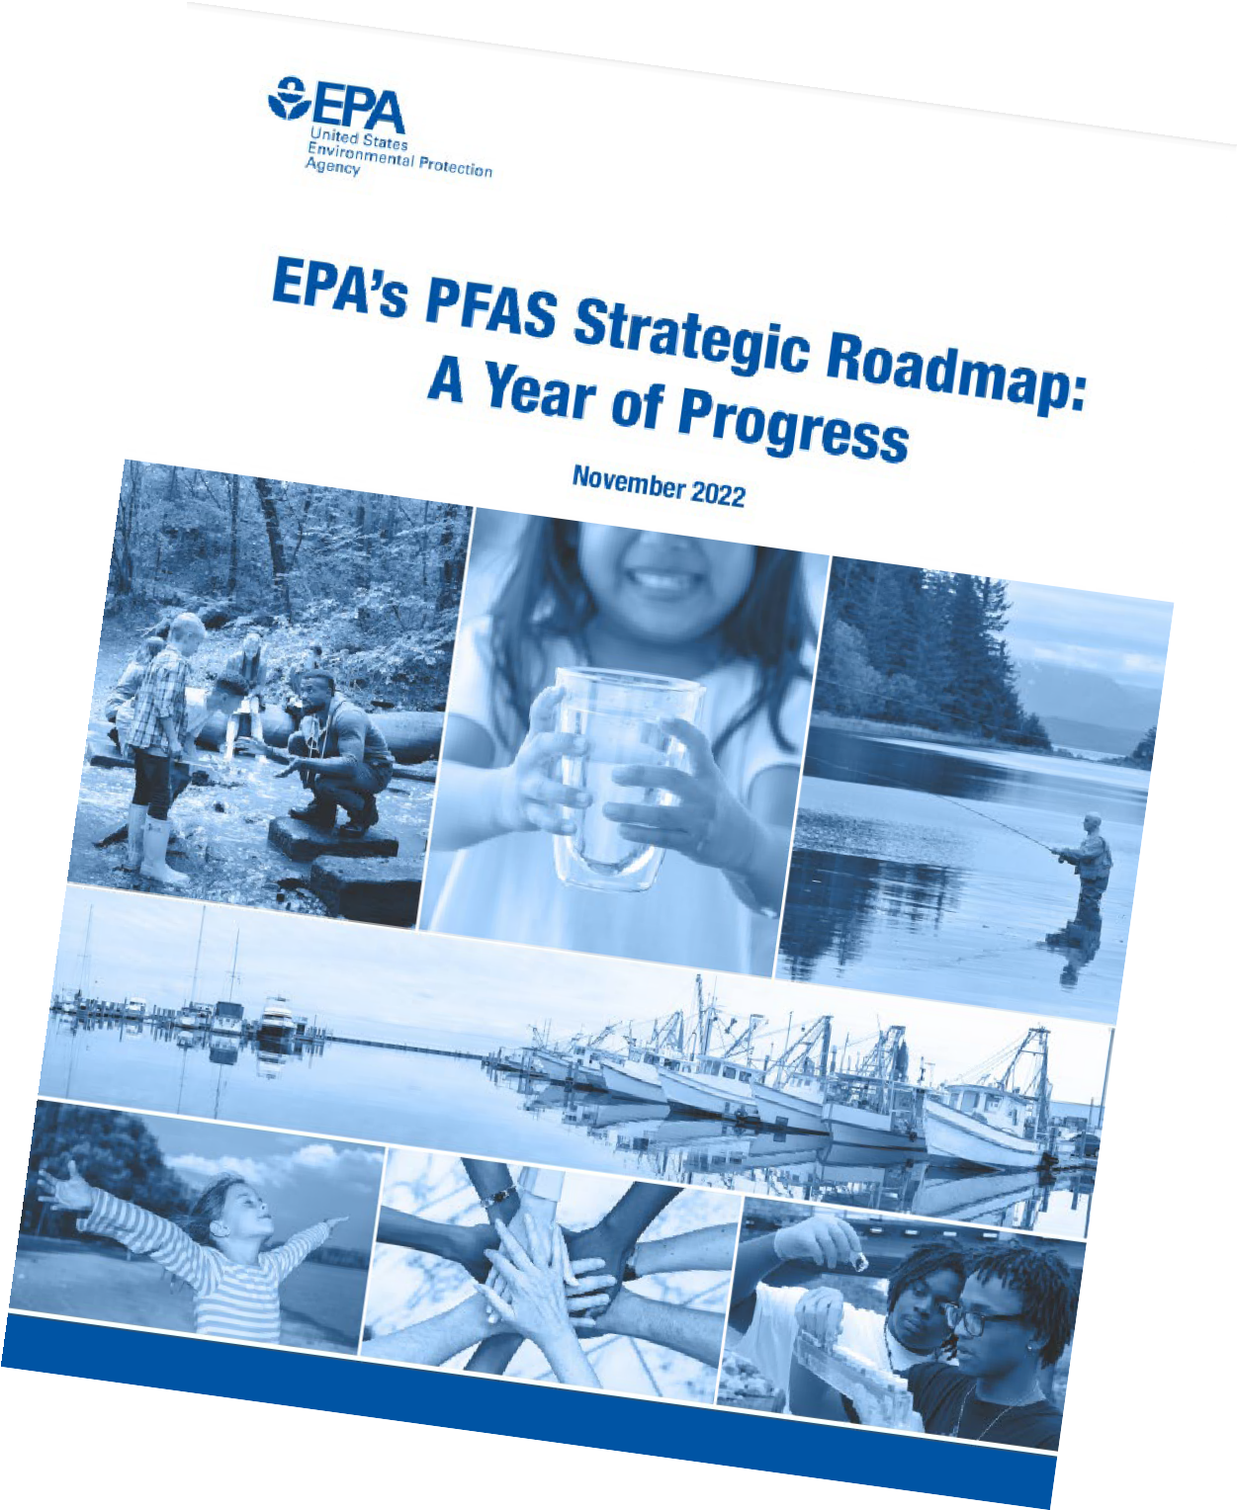
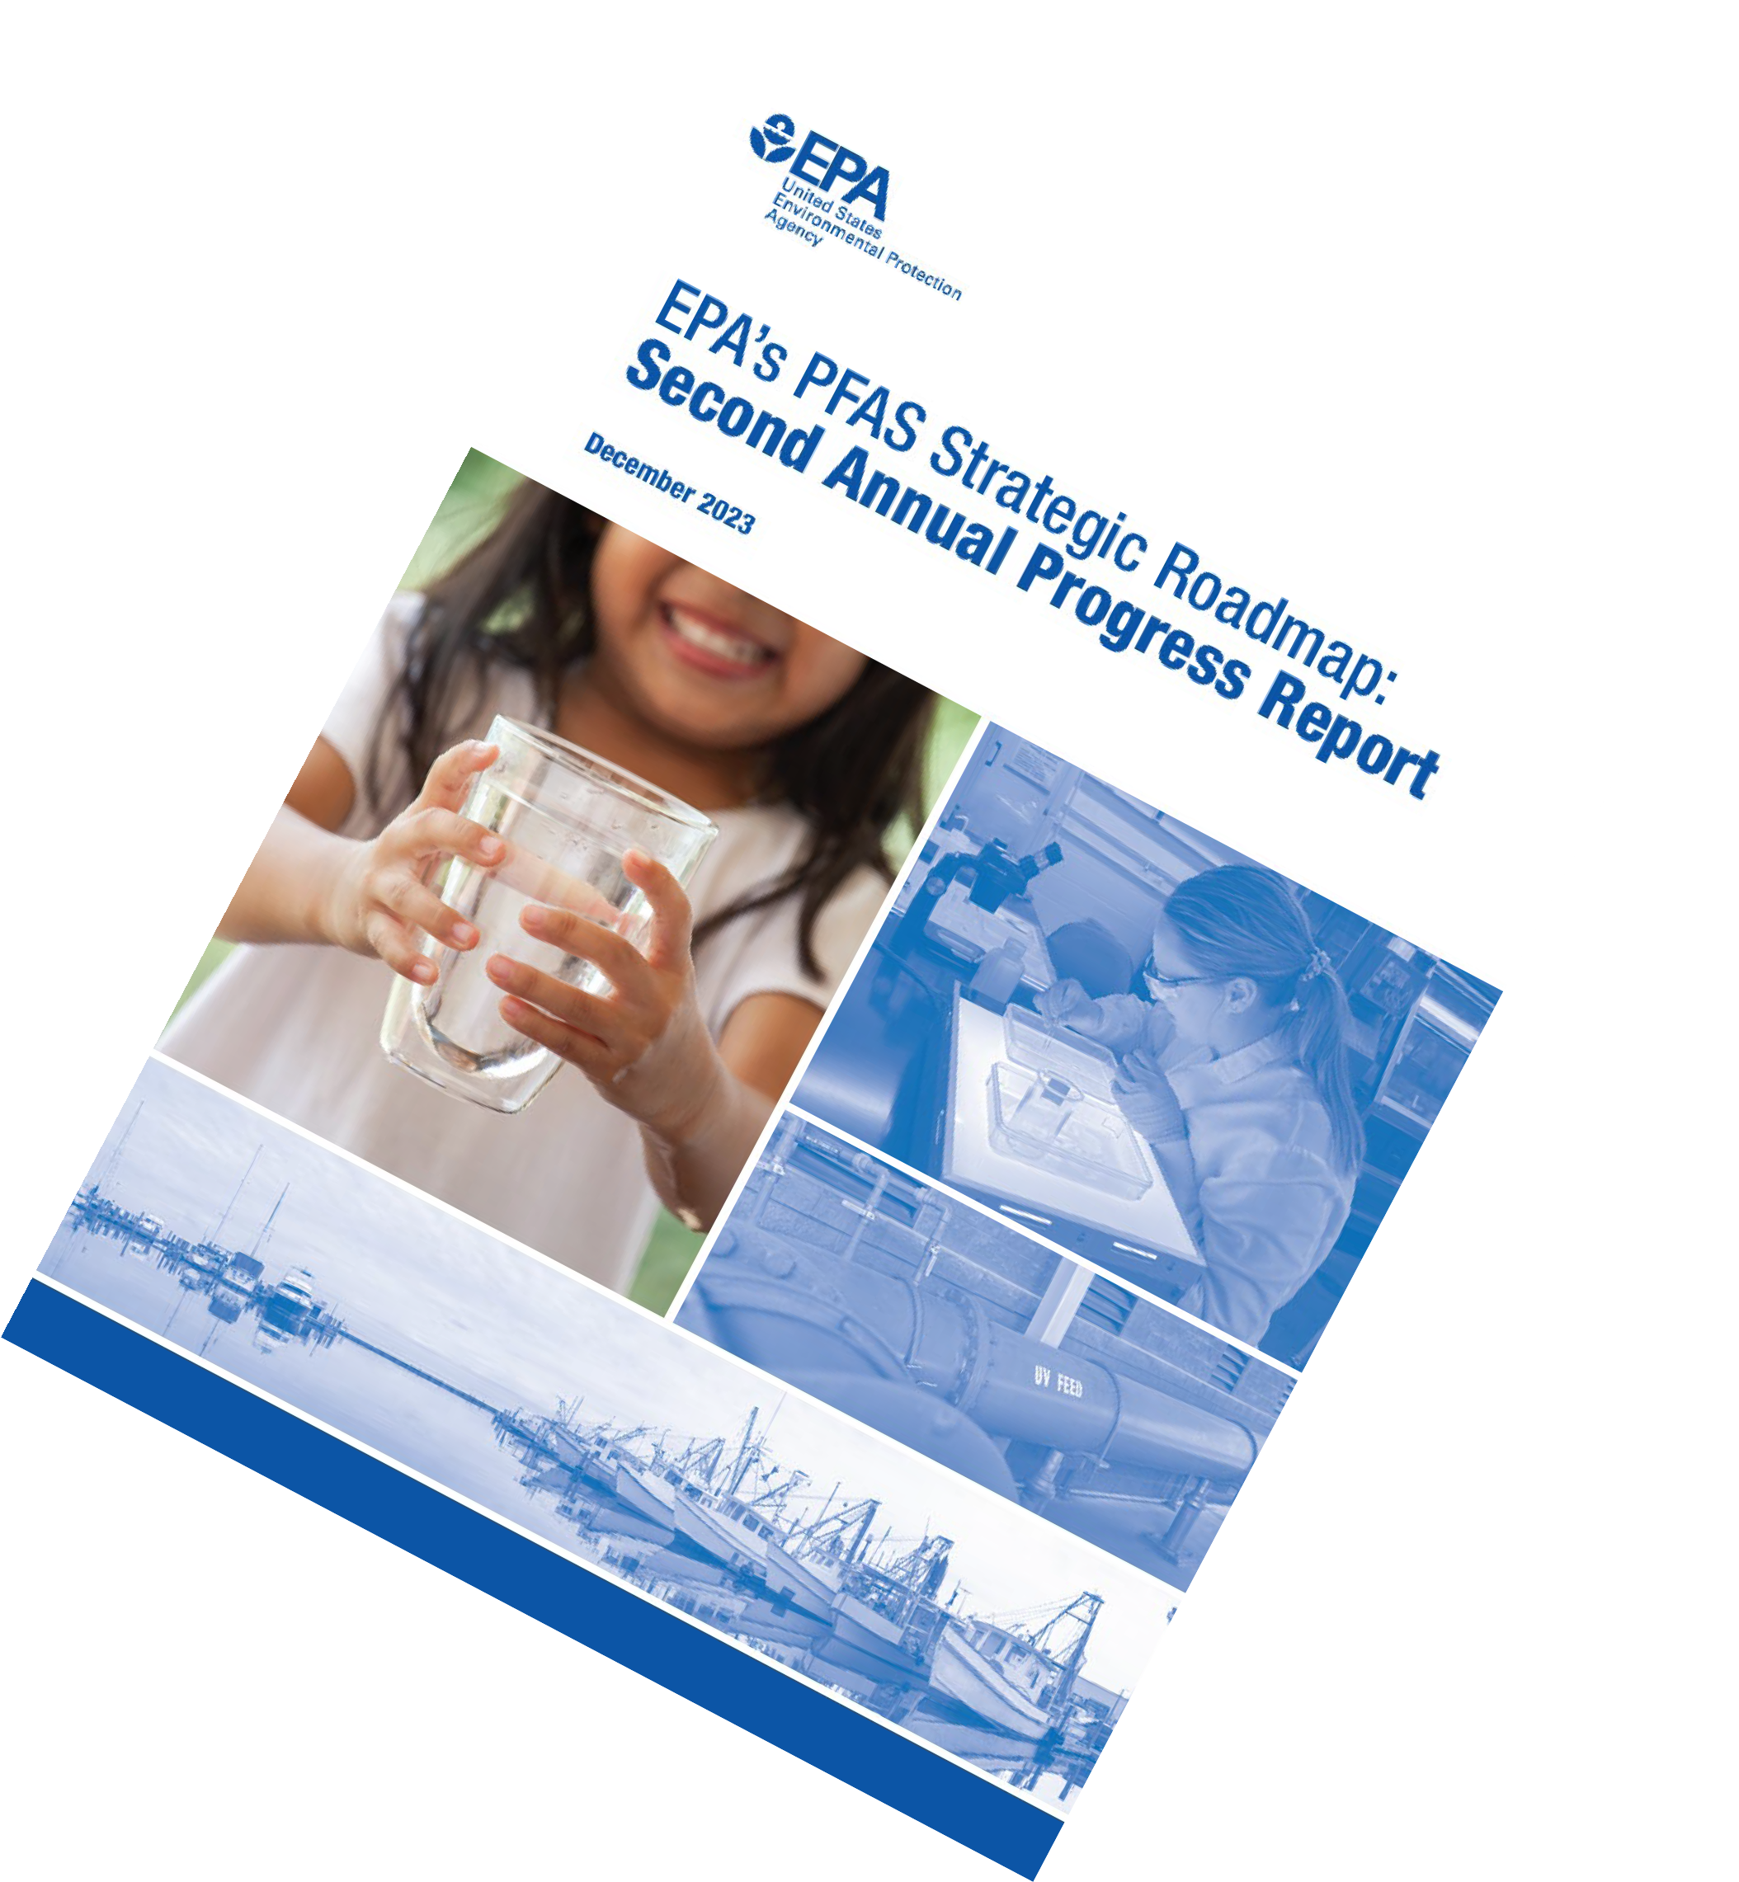
PFAS Update
epa.gov/pfas
PFAS Workshop:
Translating Research Findings to Policies that Protect Public Health and the Environment
Hosted by:
UC Berkeley Superfund Research Program David Brower Center, Berkeley, CA
Matthew Small, Ph.D,. P.G.
Regional Science Liaison
U.S. EPA Region 9 small.matthew@epa.gov
June 7, 2024
Ctrl+Click to open link for each document
1

Slide 2
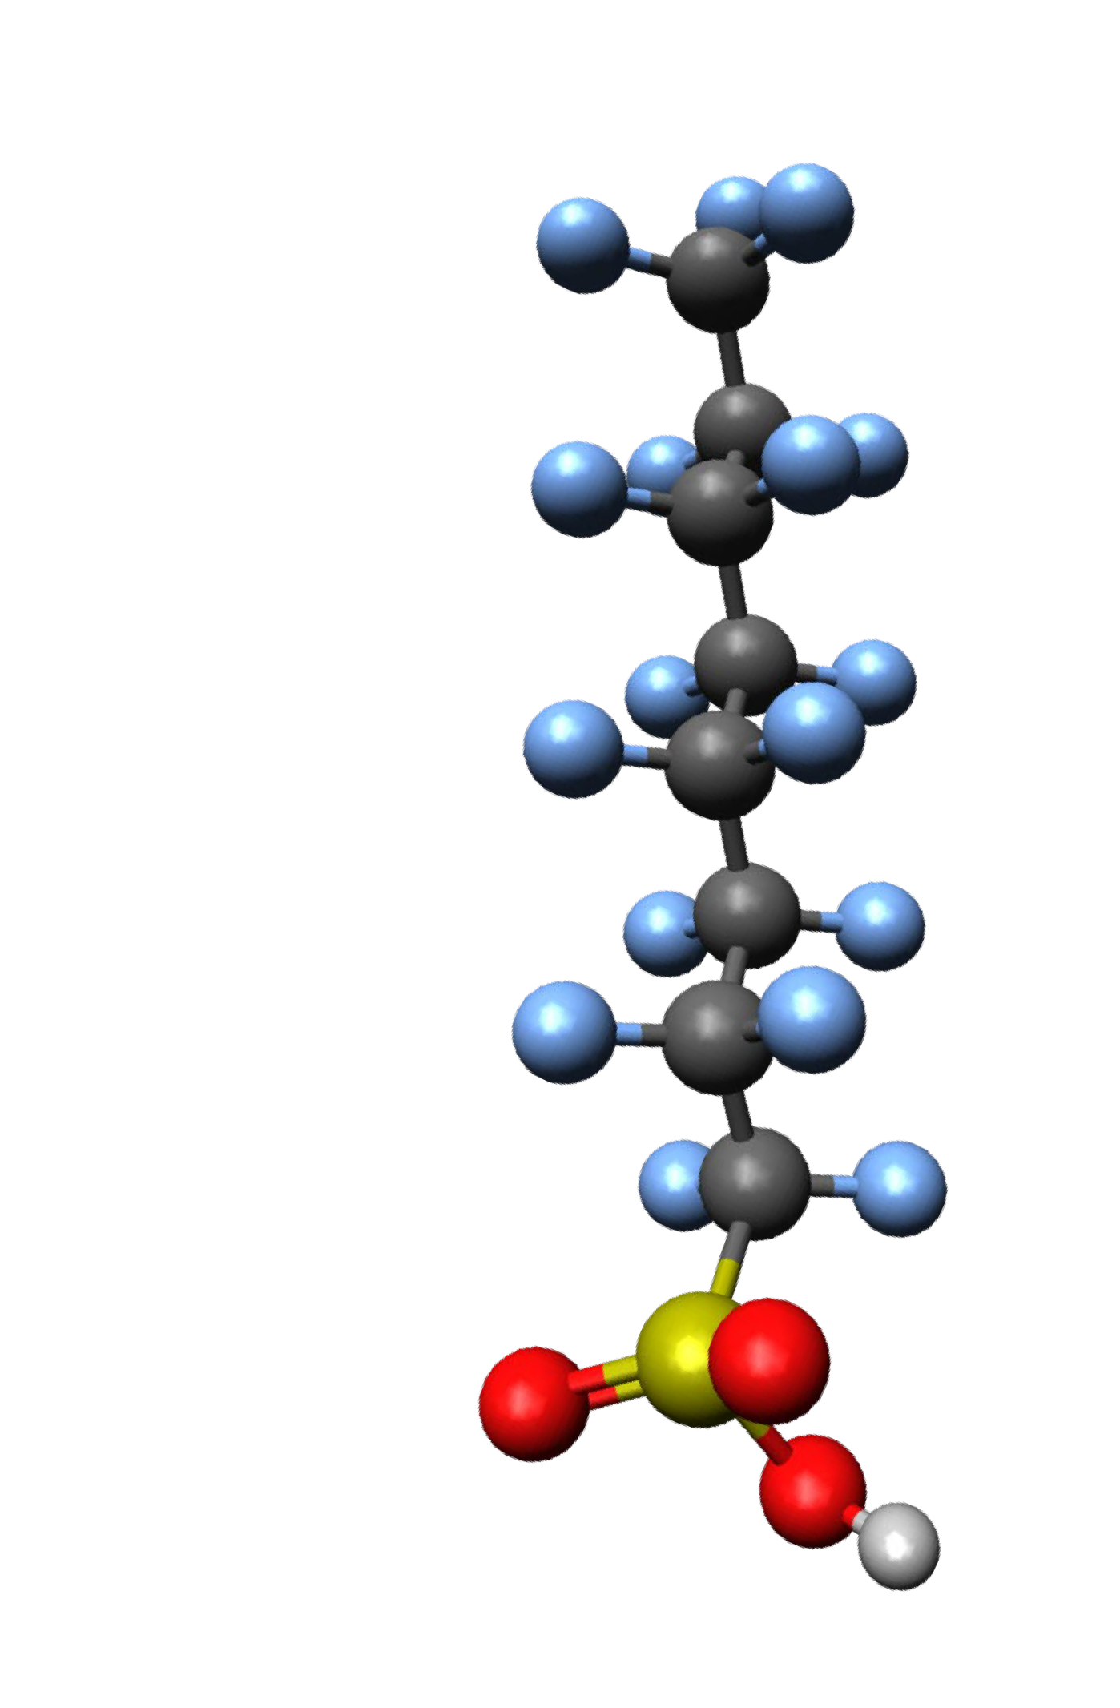
What is PFAS
Fluorine
PFOS
PFOA
Per- and polyfluoroalkyl substances (PFAS) are a group of man-made chemicals in use since the 1940s.
PFAS chemicals are widespread, toxic, bioaccumulative, mobile in the environment, and don’t break down quickly.
Known sources of PFAS:
Use of aqueous film forming foam (AFFF).
PFAS production and use in industry.
Incineration/thermal treatment facilities.
Landfills and leachates from PFAS products disposal.
Wastewater effluent and land application of biosolids.
Consumer products: cookware, food packaging, stain and water repellant fabrics, carpets and clothing.
2

Slide 3
EPA’s Goals in the PFAS Strategic Roadmap
RESEARCH
Invest in research, development, and innovation to increase understanding of
PFAS exposures and toxicities;
Human health and ecological effects; and
Effective interventions that incorporate the best- available science.
RESTRICT
Pursue a comprehensive approach to proactively prevent PFAS from entering air, land, and water at levels that can adversely impact human health and the environment.
REMEDIATE
Broaden and accelerate the cleanup of PFAS contamination to protect human health and ecological systems.
PFAS Strategic Roadmap: EPA’s Commitments to Action 2021–2024
3

Slide 4
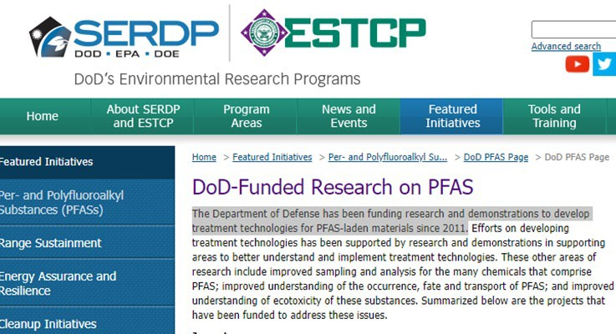
EPA PFAS Research
Dept. of Defense, EPA, Dept. of Energy (DoD-EPA-DOE) PFAS Research
Research Collaborations with CA
Methods to Detect and Quantify PFAS
Assessing PFAS Human Toxicity
Assessing PFAS Ecological Toxicity
Researching PFAS Exposure
Drinking Water Treatment Options
Cleaning Up and PFAS Contamination
Extramurally Funded Projects
PFAS Innovative Treatment Technology (PITT) Destruction/Disposal Options
Small Business Innovative Research
Research and Demonstrations
Treatment Technologies
Sampling and Analysis
Occurrence, Fate and Transport
Ecotoxicity and Ecological Risk
4

Slide 5
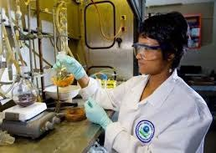
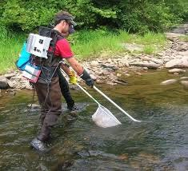
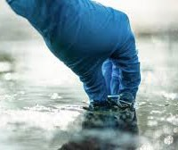
EPA PFAS Research Funding
EPA PFAS Extramural Research Funding:
Research grant funding opportunities
SBIR funding opportunities
Active challenges
Student Design Competition People Prosperity and Planet P3
EPA collaborative funding:
Strategic Env. Research and Development Program (SERDP) and the Env. Security Tech. Certification Program (ESTCP).
5

Slide 6
Examples of EPA Funded Extramural PFAS Research
PFAS uptake and bioaccumulation in plants and animals in agricultural, rural, and tribal communities (2023)
Nanosensor technology to detect, monitor, and degrade pollutants (2023)
Multimedia measurements to evaluate PFAS exposure pathways (2022)
Challenge: Innovative ways to destroy PFAS (2021)
PFAS impacts in rural communities and agricultural operations (2020)
Practical methods to analyze and treat emerging contaminants (PFAS) (2019)
Water quality and availability challenges of PFAS (2019)
6

Slide 7
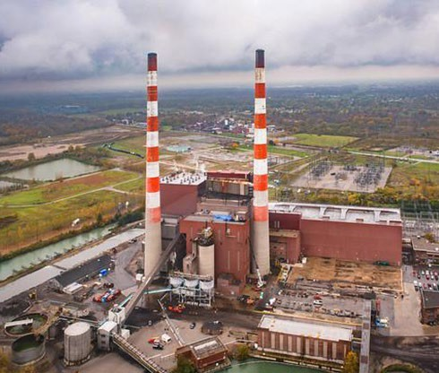
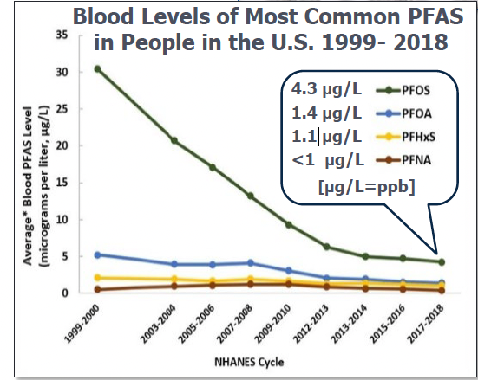
Restricting PFAS Use and Sources
Significant new use rules (SNURS) TSCA.
172 new PFAS added to TRI.
Removal of PFAS as inert ingredients in pesticides.
National PFAS Testing Strategy Test Orders requires manufacturers to provide PFAS data.
Program Plan 15, revised effluent and pretreatment standards.
Addressing PFAS in NPDES Permitting.
Risk Assessment for PFAS in biosolids.
https://www.atsdr.cdc.gov/pfas/health-effects/us-population.html

Slide 8
Restrict PFAS in Drinking Water (NEW)
National Primary Drinking Water Regulation (NPDWR/MCL) for six PFAS compounds.
New, additional $1B in funding, Investing in America for testing and treatment including
$82.9M allotted to CA for Emerging Contaminants in Small/Disadvantaged Communities.
Compound | Final MCLG | Final MCL (enforceable)
PFOA | Zero | 4.0 parts per trillion (ppt) (also expressed as ng/L)
PFOS | Zero | 4.0 ppt
PFHxS | 10 ppt | 10 ppt
PFNA | 10 ppt | 10 ppt
HFPO-DA (GenX) | 10 ppt | 10 ppt
Mixtures containing two or more of PFHxS, PFNA, HFPO-DA, and PFBS | 1 (unitless) Hazard Index | 1 (unitless) Hazard Index
8

Slide 9
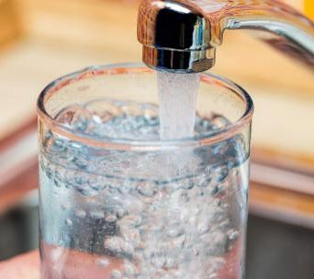
Restrict PFAS in Drinking Water
EPA drinking water method for 29 PFAS (537.1 and 533).
CA Research collaboration on Non-Targeted PFAS Analysis.
EPA Drinking Water Treatability Database with treatment options to remove 37 PFAS compounds.
Existing Bipartisan Infrastructure Law (BIL) funding:
$4B Drinking Water State Revolving Fund
$1B Clean Water State Revolving Fund
$5B Small or Disadvantaged Communities Grants including $169M to CA for PFAS/emerging contaminants.
https://www.epa.gov/pfas
9

Slide 10
Remediate (NEW)
CERCLA Hazardous Substance designation:
CERCLA Enforcement discretion
Focus on "holding responsible those who significantly contributed to the release of PFAS into the environment …."
“EPA does not intend to pursue entities where equitable factors do not support actions or costs under CERCLA,"
including farmers, water utilities, airports, or local fire departments.”
Release reporting.
Federal Land Transfer Requirements.
DOT regulations.
Response without “imminent and substantial danger" finding.
Compel PRPs to clean up.
Two additional proposed rules under RCRA:
Proposal to List 9 PFAS as RCRA Hazardous Constituents.
Authority to address Releases of PFAS and emerging contaminants at TSDs.
10

Slide 11
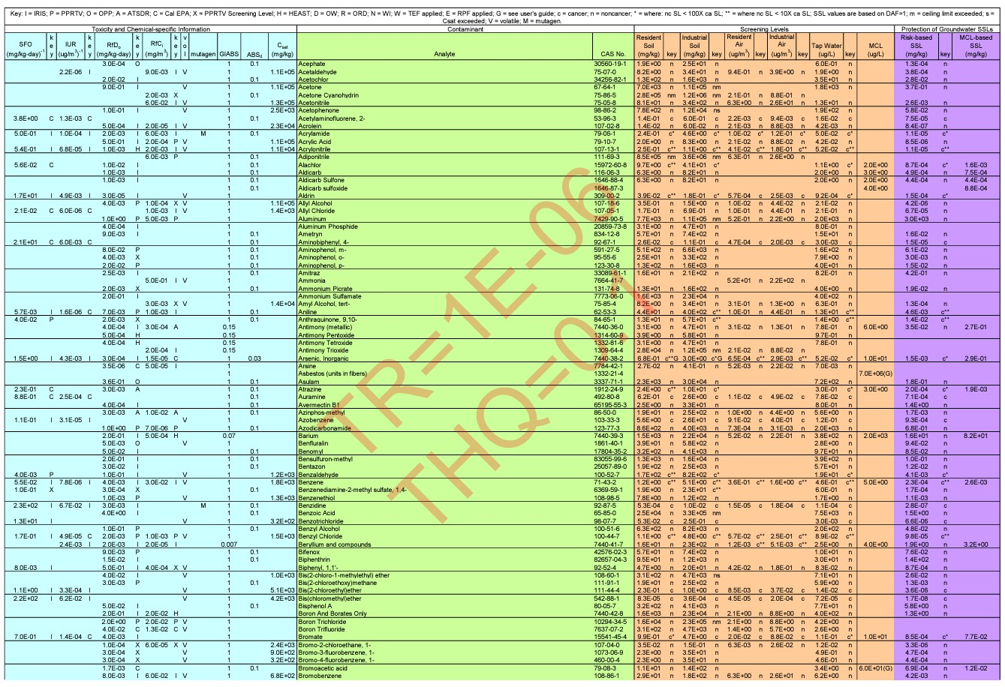
Remediate
Revised Regional Screening Levels to help guide cleanup decisions (ongoing).
RSL/RML/VISL tables.
The RSL Calculator.
MCLs are potential “applicable or relevant and appropriate requirements (ARARs)” at CERCLA sites.
Draft Aquatic Life Criteria for PFOA and PFOS.
Analytical Methods:
EPA Method 1633 for 40 PFAS in multiple media.
Method 1621 for Adsorbable Organic Fluorine in wastewater.
11

Slide 12
PFAS Destruction and Disposal (NEW)
Interim Guidance on Destruction and Disposal of PFAS and Materials Containing PFAS
V2 (April, 2024)
Contents:
Description of PFAS-Containing Materials.
Technologies for the Destruction and Disposal of PFAS and PFAS-Containing Materials.
Considerations for Potentially Vulnerable Populations Living Near Likely Destruction or Disposal Sites.
Research Needs and Data Gaps.
Emerging Technologies.
Interim Guidance on Destroying and Disposing of Certain PFAS and PFAS-Containing Materials
Key findings:
Interim storage with controls may be a short- term option.
Class I UIC wells are an option. But may not be appropriate or available everywhere.
Permitted hazardous waste landfills with leachate controls.
Permitted hazardous waste combustors May be an option, but uncertainties remain.
Appendices:
EPA Guidance to Conduct PFAS Emissions Field Testing at Commercial Thermal Destruction Sources.
Summary of the Clean Harbors Test.
Summary of the Chemours Thermal Oxidizer Test.
Summary of Costs and Considerations.
EPA is seeking input on this updated interim guidance.
12

Slide 13
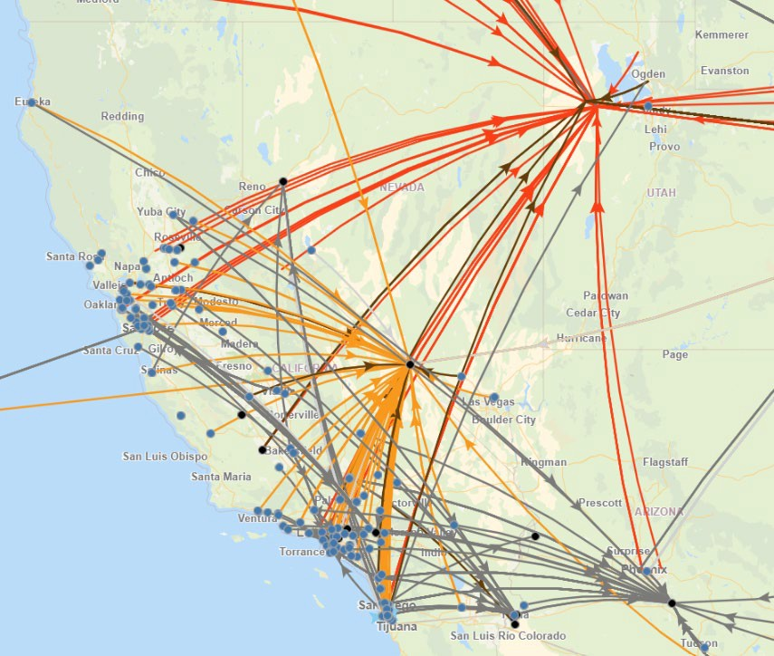
PFAS Destruction and Disposal
ORD evaluation of incineration and destruction efficiency for simple PFAS.
Some promising technologies are being developed through SBIR, EPA research, and external research.
PFAS Innovative Treatment Team (PITT).
ORD Modeling PFAS Air Emissions, Deposition, and Chemistry.
PFAS Destruction Challenge.
R9 Sites Receiving PFAS for Disposal
13

Slide 14
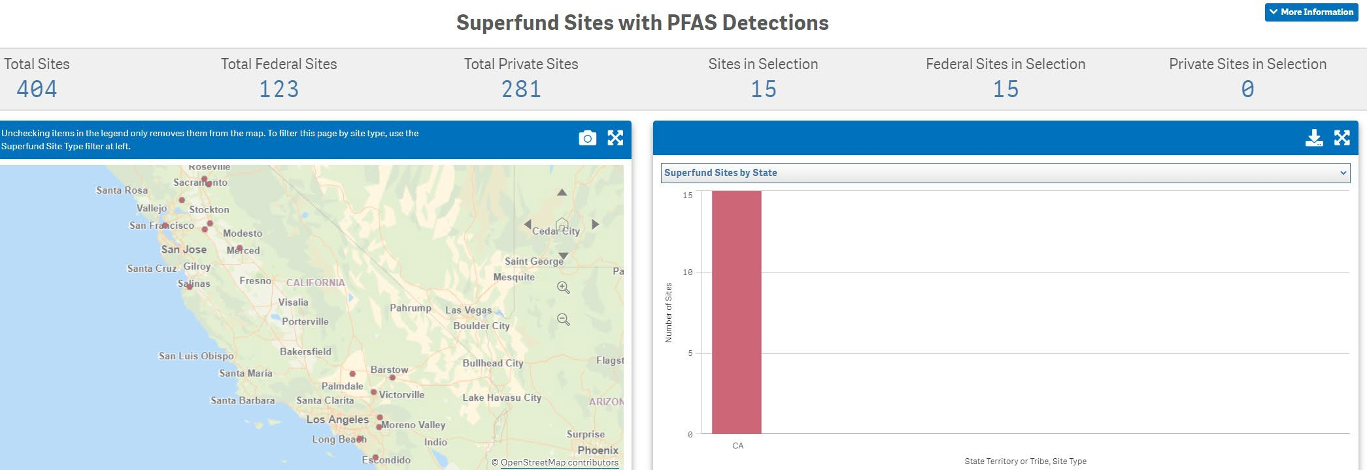
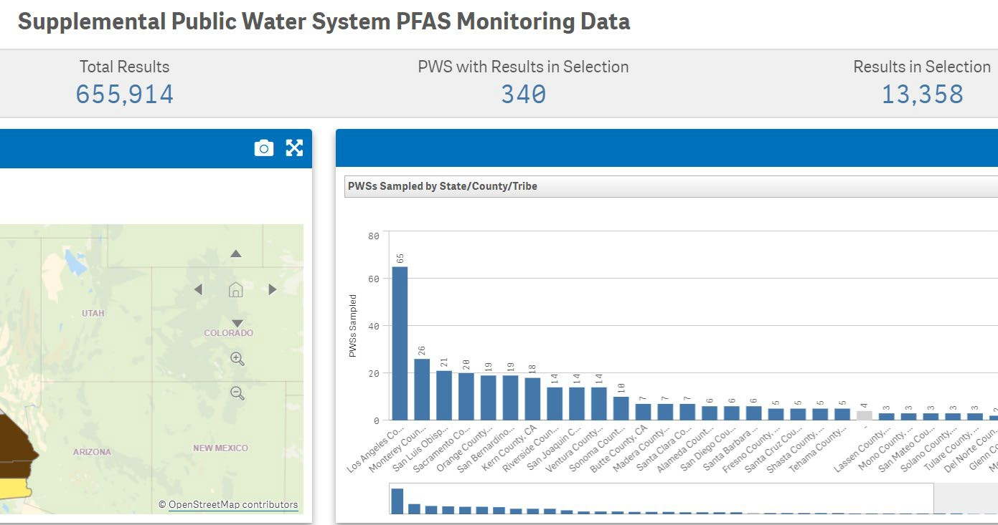
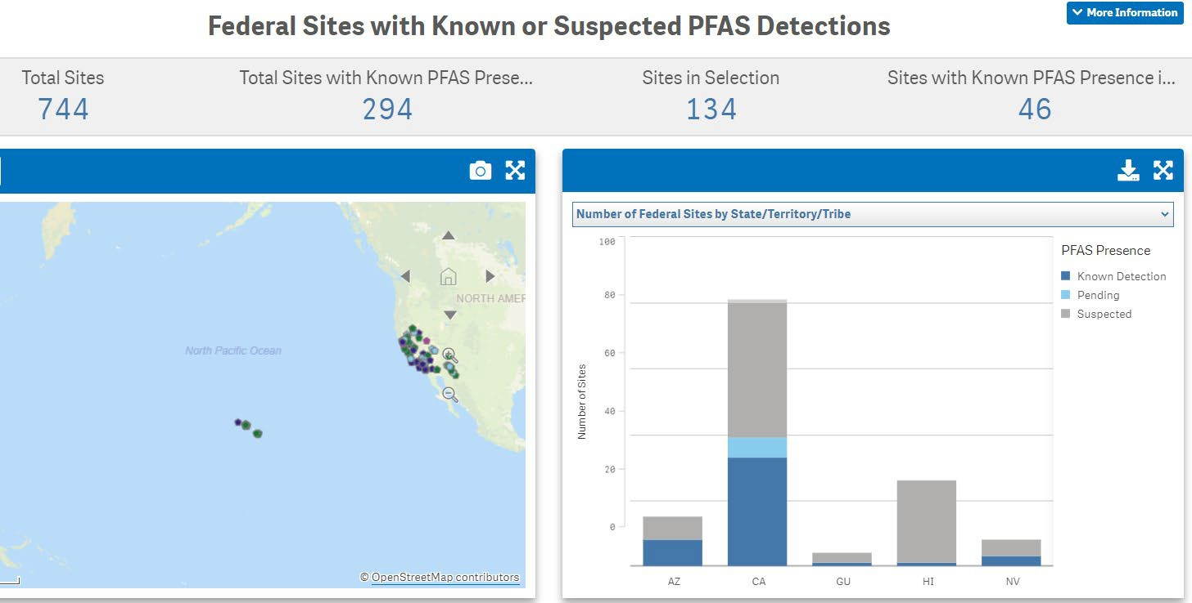
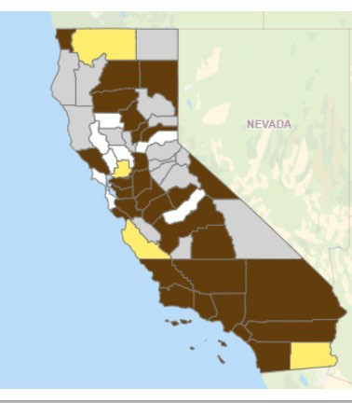
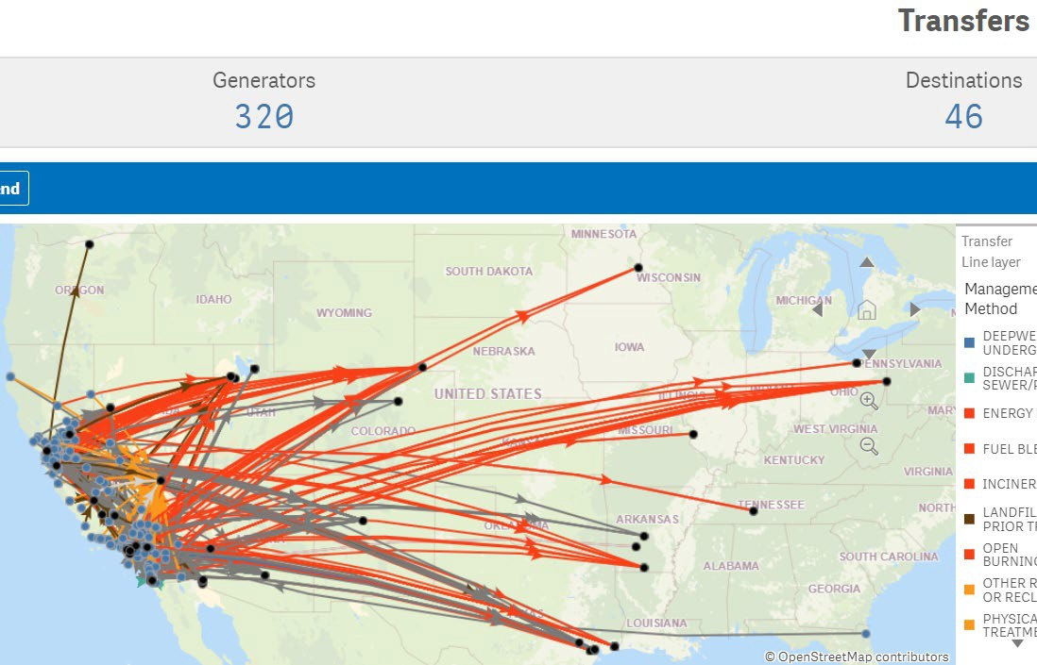
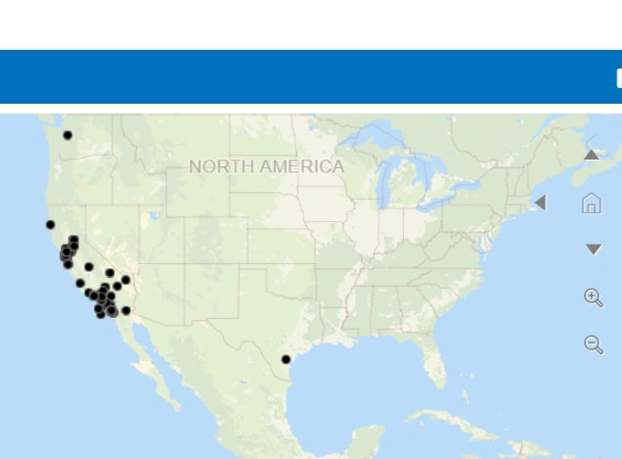
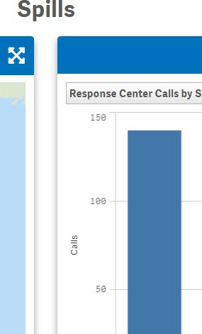
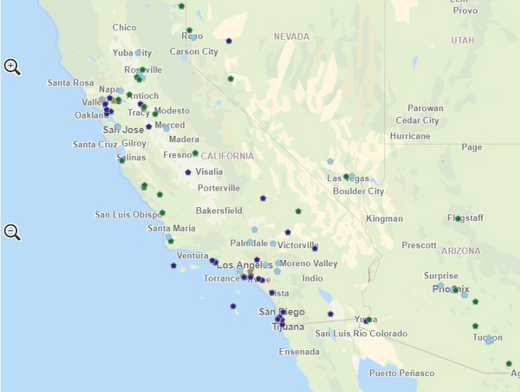
EPA PFAS Data Collection and Analytic Tools
Fifth Unregulated Contaminant Monitoring Rule (UCMR5), National sampling, 29 PFAS: Initial data release (24% of total results EPA expects over years 2023-25).
Enforcement and Compliance History Online ECHO PFAS Analytic Tools. National level data from readily accessible, public information repositories.
https://echo.epa.gov/trends/pfas-tools

Slide 15
Thank you for your Attention
Matt Small, Regional Science Liaison
U.S. EPA Region 9, small.matthew@epa.gov
EPA PFAS Web Site EPA PFAS Press Releases
15

