Slide 1



Thoughts on “Selective Quantification of
Charged and Neutral Polyfluoroalkyl Substances
Using the Total Oxidizable Precursor (TOP) Assay*
Edmund H. Antell, Shan Yi, Christopher I. Olivares, Shreya Chaudhuri,
Bridger J. Ruyle, Lisa Alvarez-Cohen, David L. Sedlak
*Paper in Press at Environmental Science & Technology

Slide 2
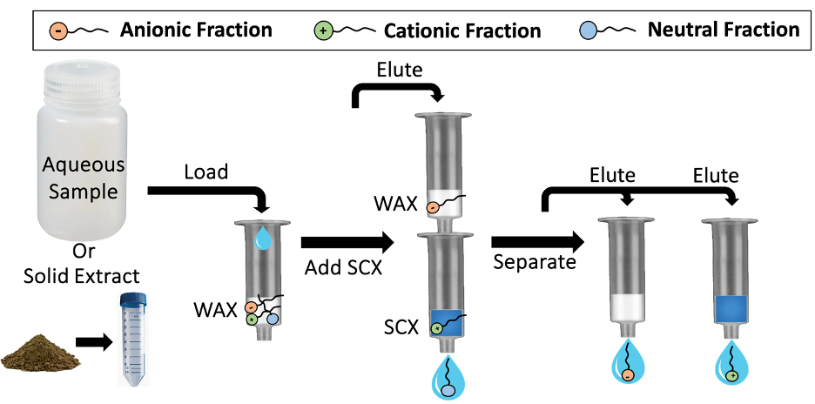
Motivation and Approach
(CH₃OH)
(2% NH₄OH/CH₃OH)
(1% NH₄OH/CH₃OH&1 mM TMA/CH₃OH)

Slide 3
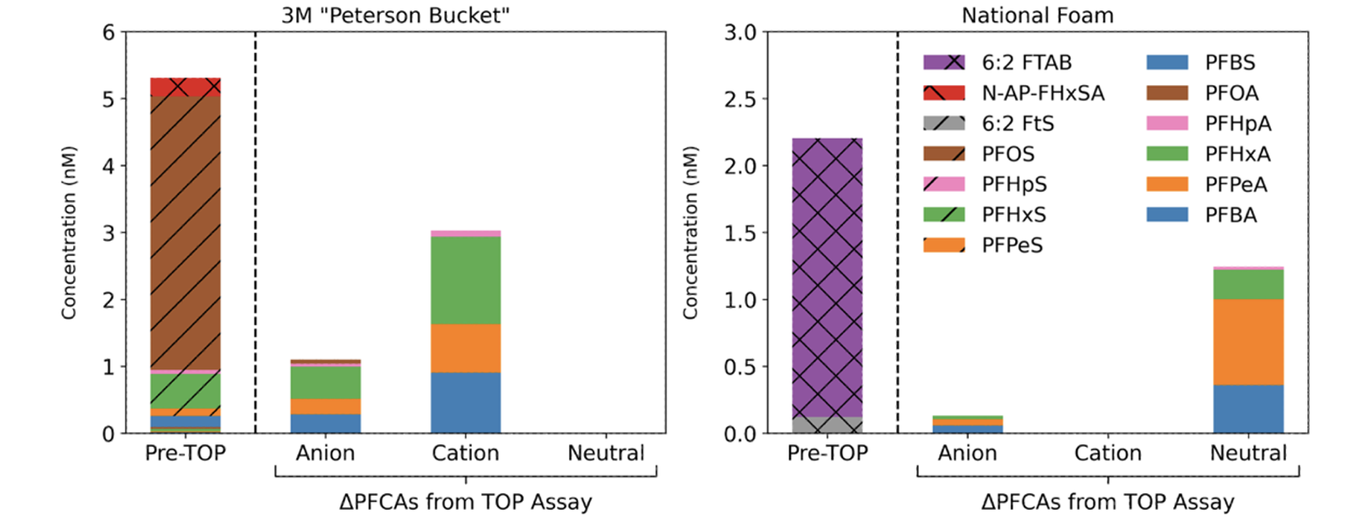
Source Characterization: AFFF

Slide 4
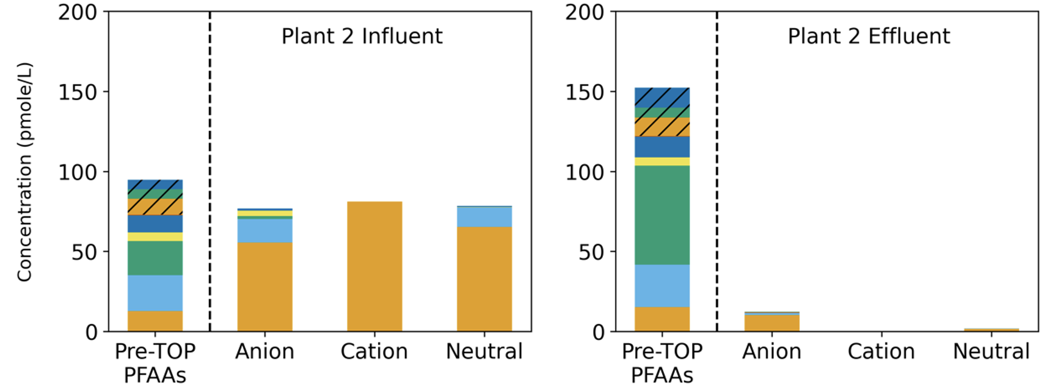
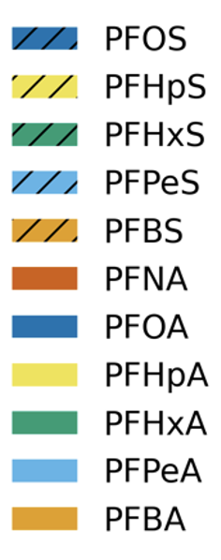
Source Characterization: Wastewater

Slide 5
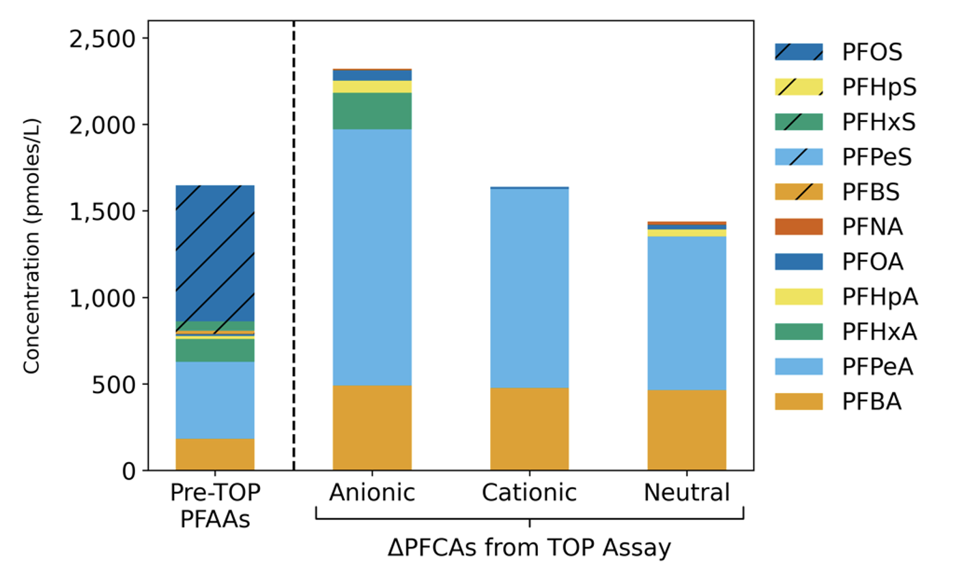
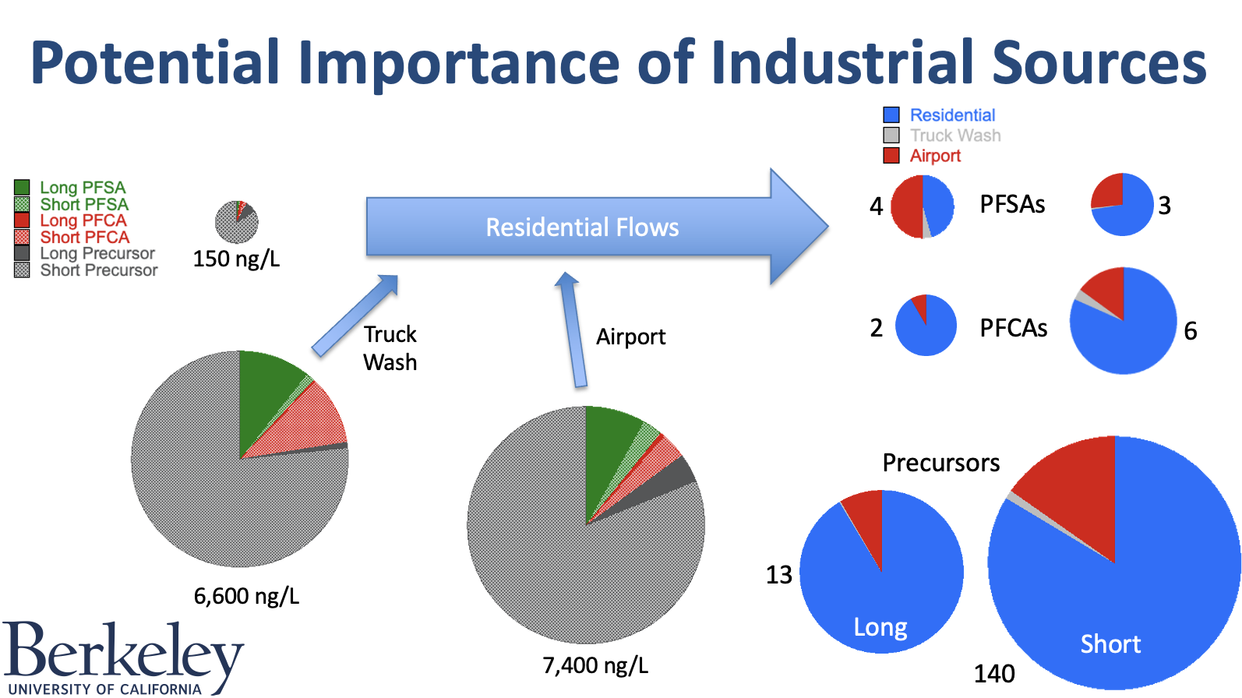
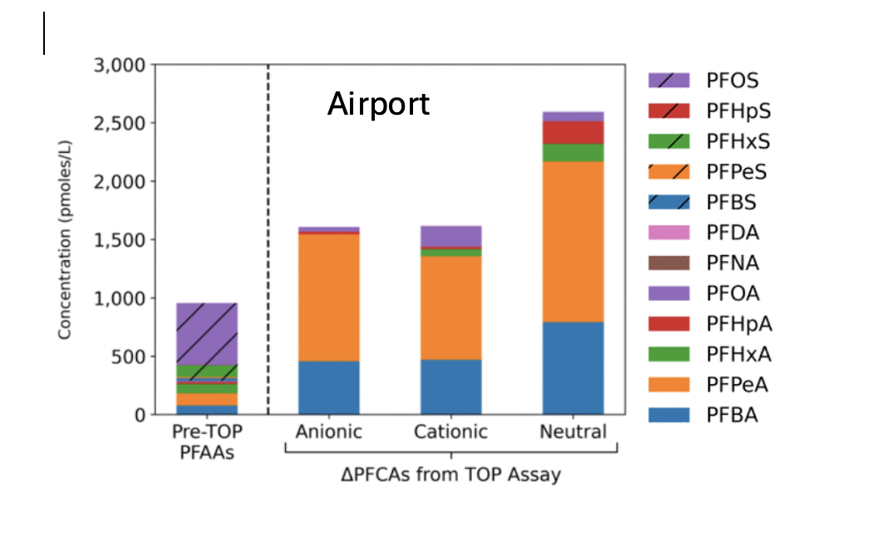
Precursor Sources & Forensics
Truck Wash

Slide 6
Considerations for Future Research
Despite recent decreases in concentrations, municipal wastewater effluent still contains long chain (MCL target) PFAS and their precursors at concentrations above the EPA MCLs.
In treated wastewater from a large sewershed residential sources of PFAS and precursors account for over 80% of the loading.
California is starting an important experiment on residential PFAS sources, but no one is monitoring it seriously.
These tools and approach may be useful for agricultural and industrial source tracking.

