Slide 1
Measuring the Cumulative Biological Impact of Psychosocial Stress and Chemical Exposures
Rosemarie de la Rosa, PhD, MPH (rmd1025@berkeley.edu)
Assistant Professor of Environmental Health Science
UCB SRP PFAS Community of Practice
March 3, 2025

Slide 2
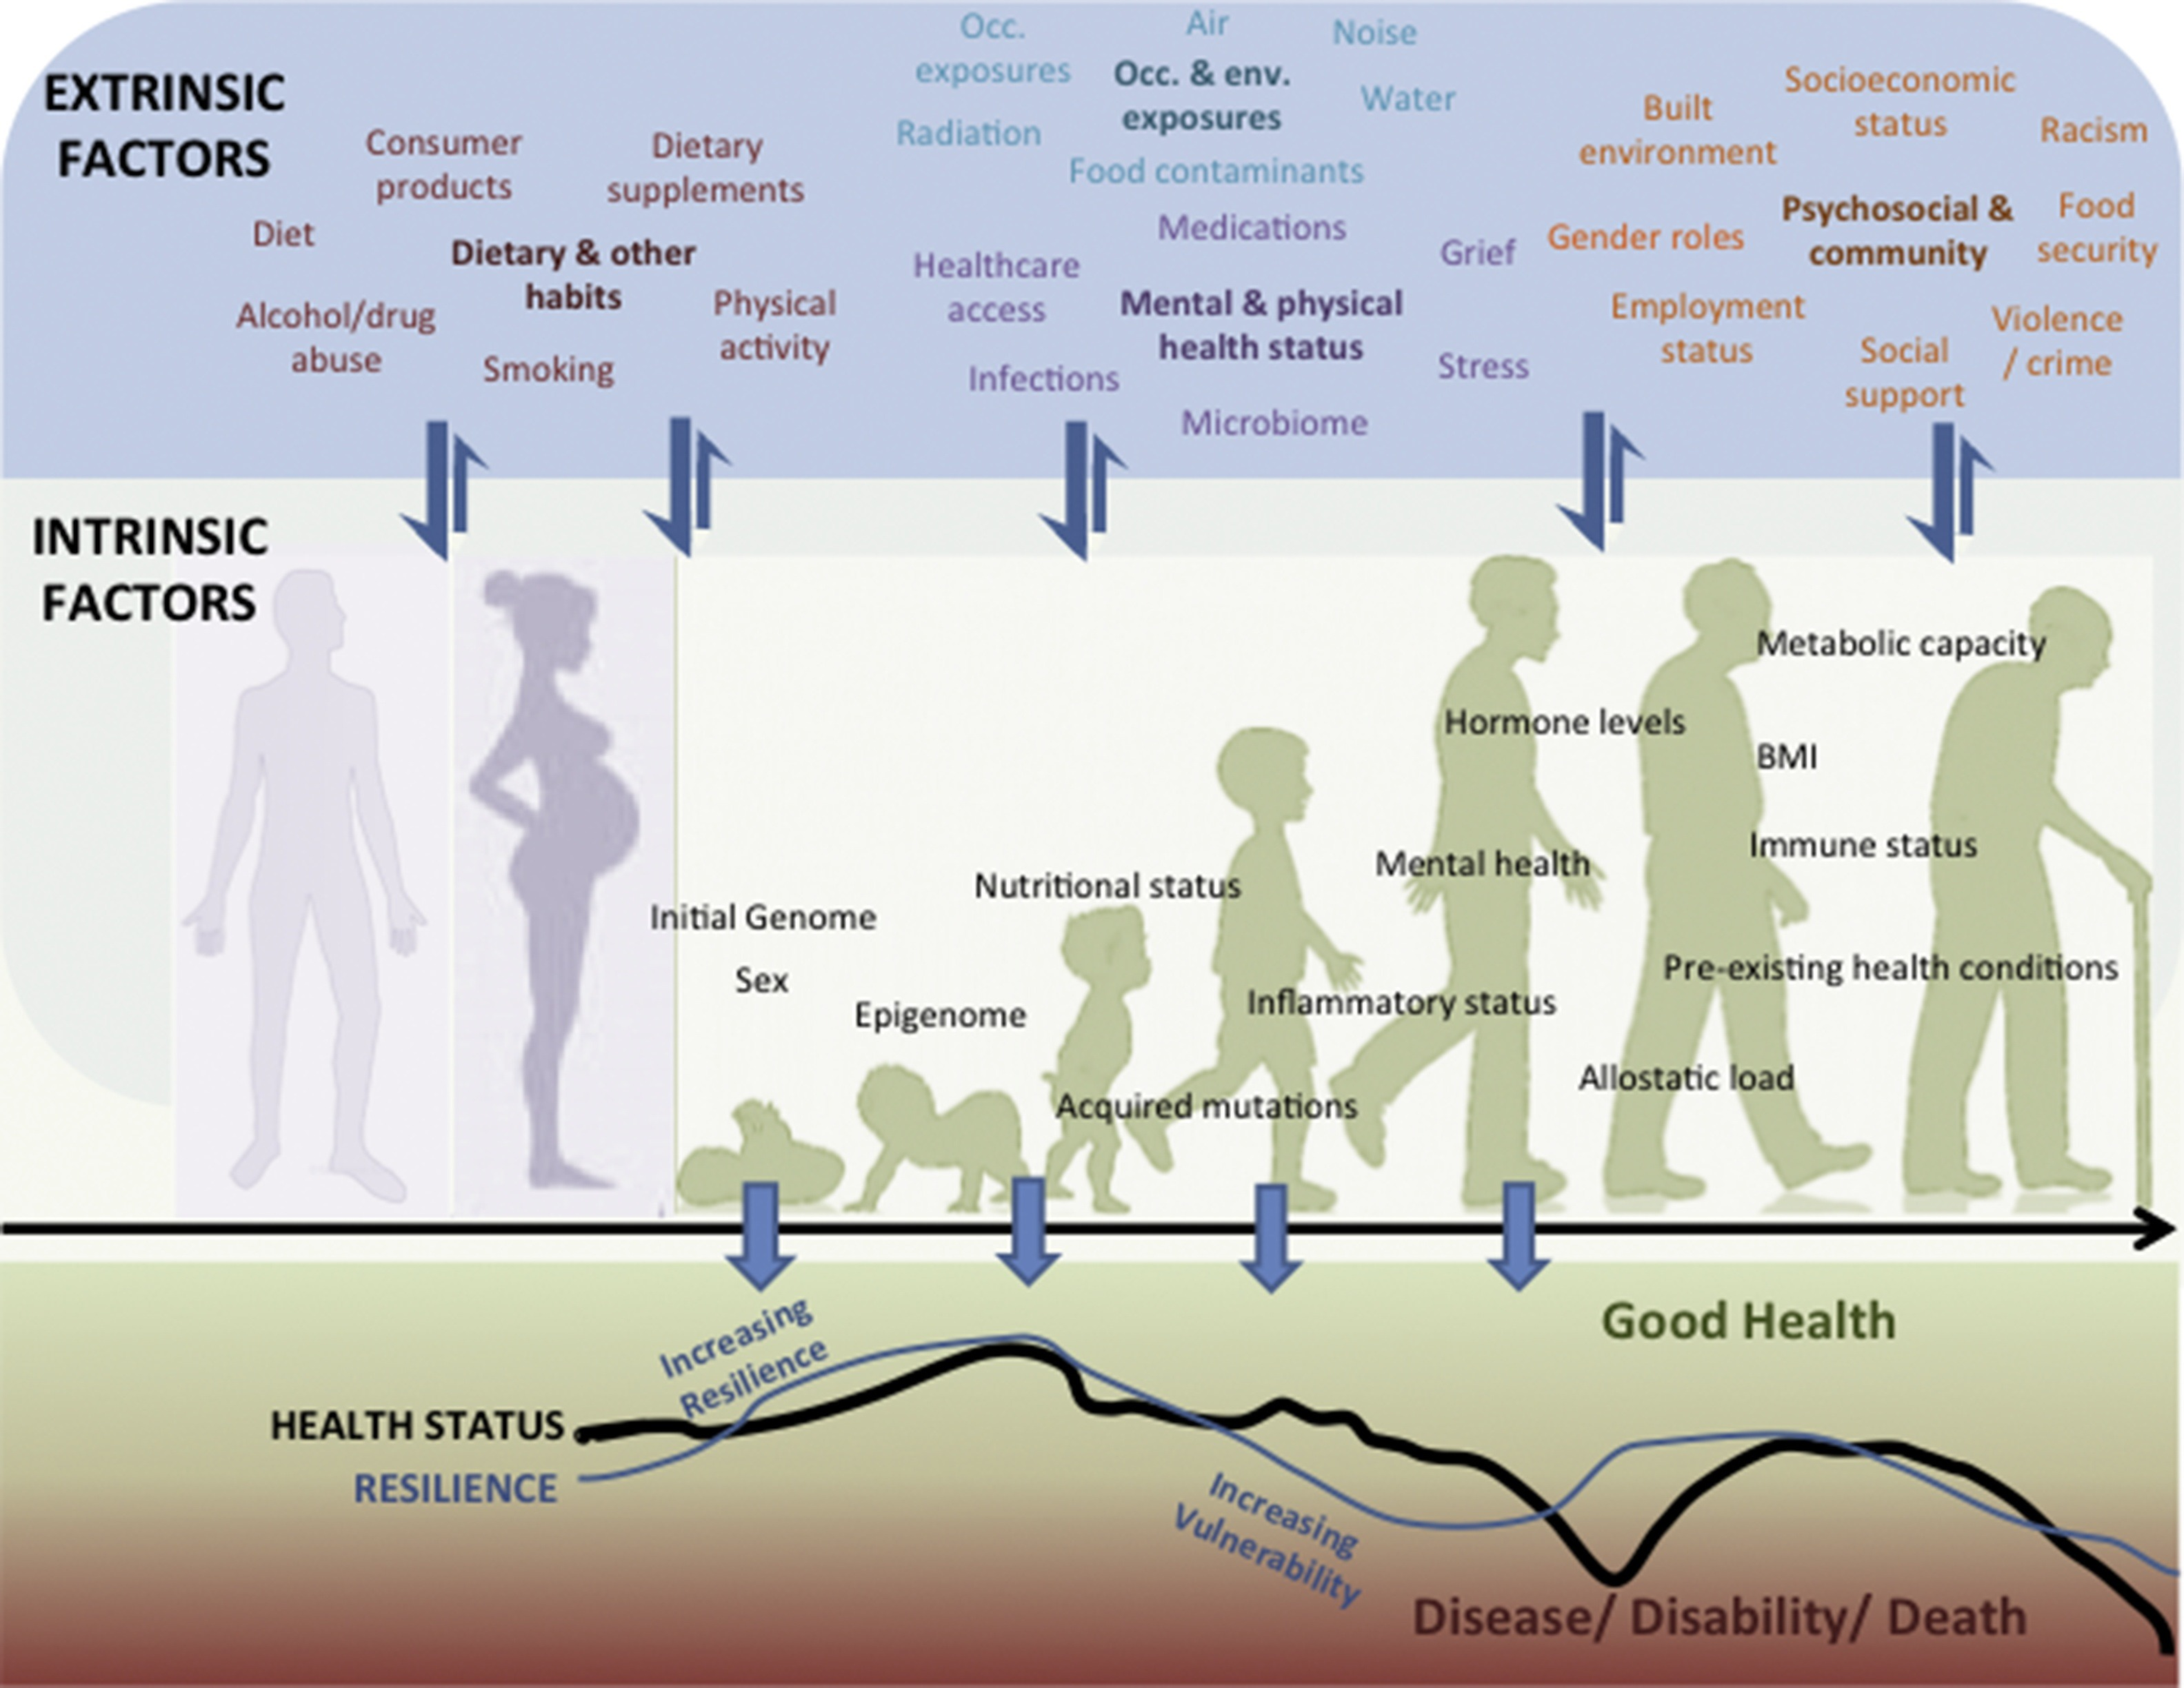
Interaction of Intrinsic and Extrinsic Factors Across the Lifetime
McHale et al., Mutation Research/Reviews in Mutation Research, 2018; 775: 11-20

Slide 3
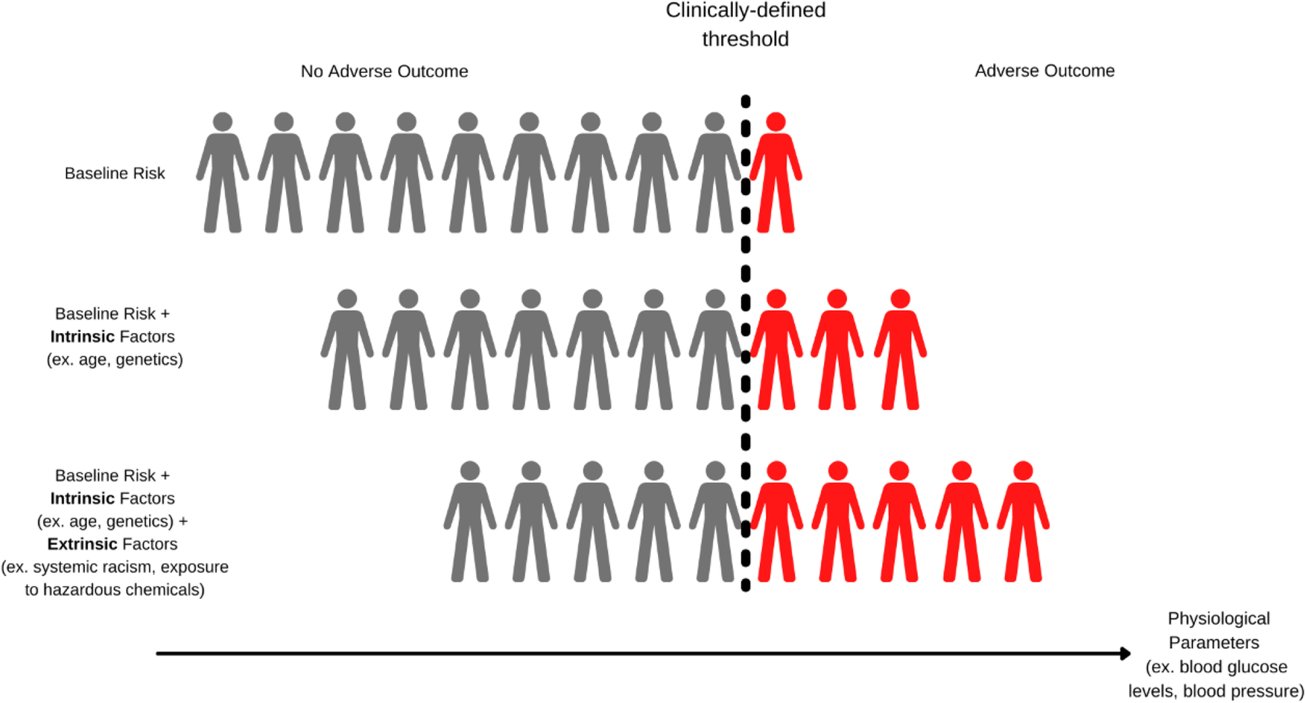
How Intrinsic and Extrinsic Factors Influence Risk of an Adverse Outcome
Varshavsky, J.R. et al. Environ Health 21 (Suppl 1), 133 (2023)

Slide 4
Cumulative Impacts are the totality of exposures to combinations of chemical and nonchemical stressors and their effects on health and quality-of-life outcome. (U.S. EPA 2022)
“disadvantaged, underserved, and overburdened communities come to the table with preexisting deficits of both a physical and social nature that make the effects of environmental pollution more, and in some cases unacceptably, burdensome.”
National Environmental Justice Advisory Council (NEJAC), 2004

Slide 5
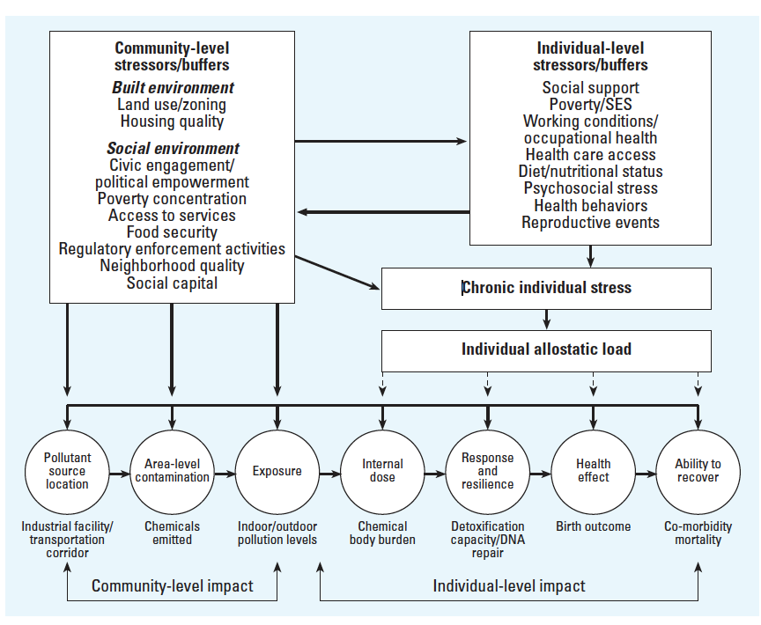
Community and Individual Stressors/Buffers Influence Susceptibility to Environmental Hazards
Chemical stressors
Morello-Frosch R & Shenassa ED, Environmental Health Perspective. 2006 Apr 6;114(8):1150–1153

Slide 6
Community and Individual Stressors/Buffers Influence Susceptibility to Environmental Hazards 2
Non-chemical stressors
Chemical stressors
Morello-Frosch R & Shenassa ED, Environmental Health Perspective. 2006 Apr 6;114(8):1150–1153

Slide 7
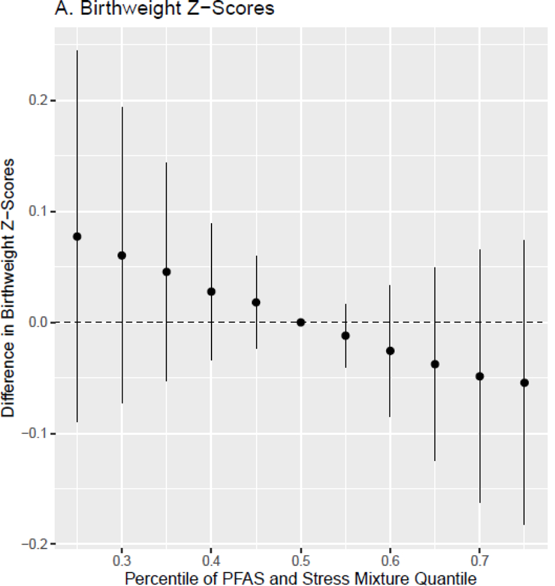
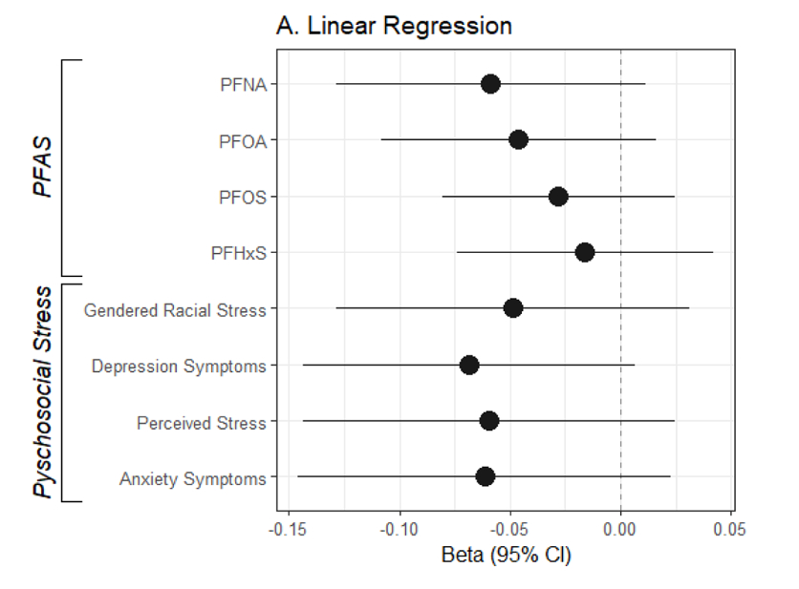
Simultaneously Exposure to PFAS and Psychosocial Stressors Associated with Reduced Birthweight
birthweight for gestational age z-scores
Eick et al. Sci Total Environ. 2022 Oct 14;857(Pt 2):159450

Slide 8
Community and Individual Stressors/Buffers Influence Susceptibility to Environmental Hazards 3
Non-chemical stressors
Chemical stressors
Morello-Frosch R & Shenassa ED, Environmental Health Perspective. 2006 Apr 6;114(8):1150–1153

Slide 9
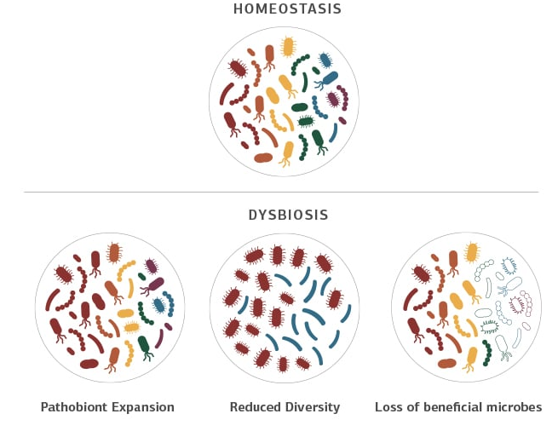
Biological Embedding of Social Environment
Neuroendocrine and Inflammatory
Allostatic Load
Genetic and Epigenetic
Microbiome
Neuroplasticity
Hertzman. PNAS. (2012)

Slide 10
Allostatic Load (AL)
Chronic stress causes physiological “wear and tear”
Cortisol
Epinephrine
Adapted from Matteri, Carroll & Dyer, 2000, Adapted from Matteri, Carroll & Dyer, 2000, McEwen BS Ann N Y Acad Sci. (1998), Thomson. Journal of Alzheimer’s Disease (2019)

Slide 11
Measuring Allostatic Load (AL)
Allostatic Load
Primary Outcomes
Epinephrine/Norepinephrine
Tertiary Outcomes
Secondary Outcomes
Cortisol
Cardiovascular: Systolic and Diastolic Blood pressure
Immune: C-reactive protein & cytokines
Poor Health
Cognitive Decline
Metabolic: Waist-hip ratio, HDL, total cholesterol, HbA1c
DHEA-S
Cortisol
Epinephrine
Adapted from Matteri, Carroll & Dyer, 2000, Adapted from Matteri, Carroll & Dyer, 2000, McEwen BS Ann N Y Acad Sci. (1998), Thomson. Journal of Alzheimer’s Disease (2019)

Slide 12
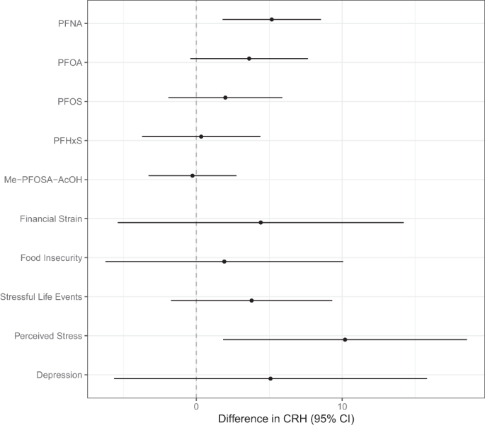
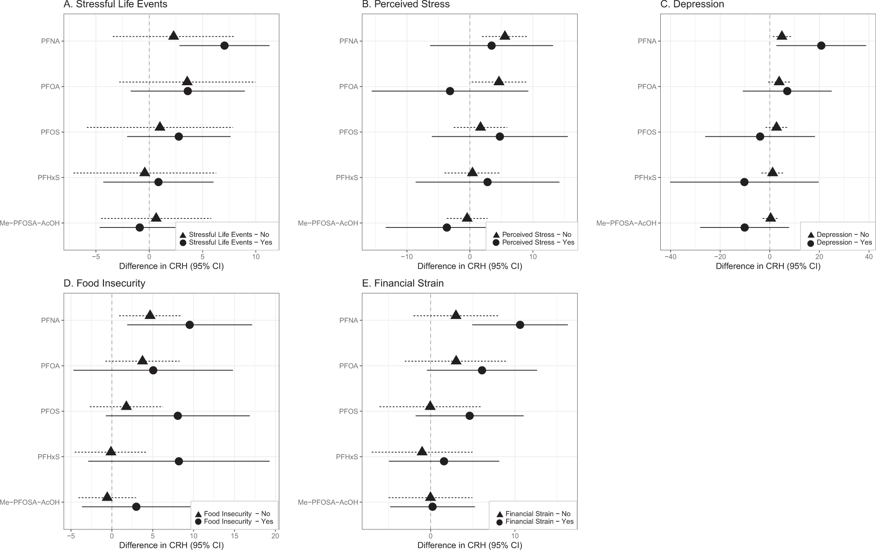
Relationship Between PFAS and CRH levels in Mid-gestation Stronger Among Women Who Experienced Stress
Eick et al. Journal of Exposure Science & Environmental Epidemiology (2022)

Slide 13
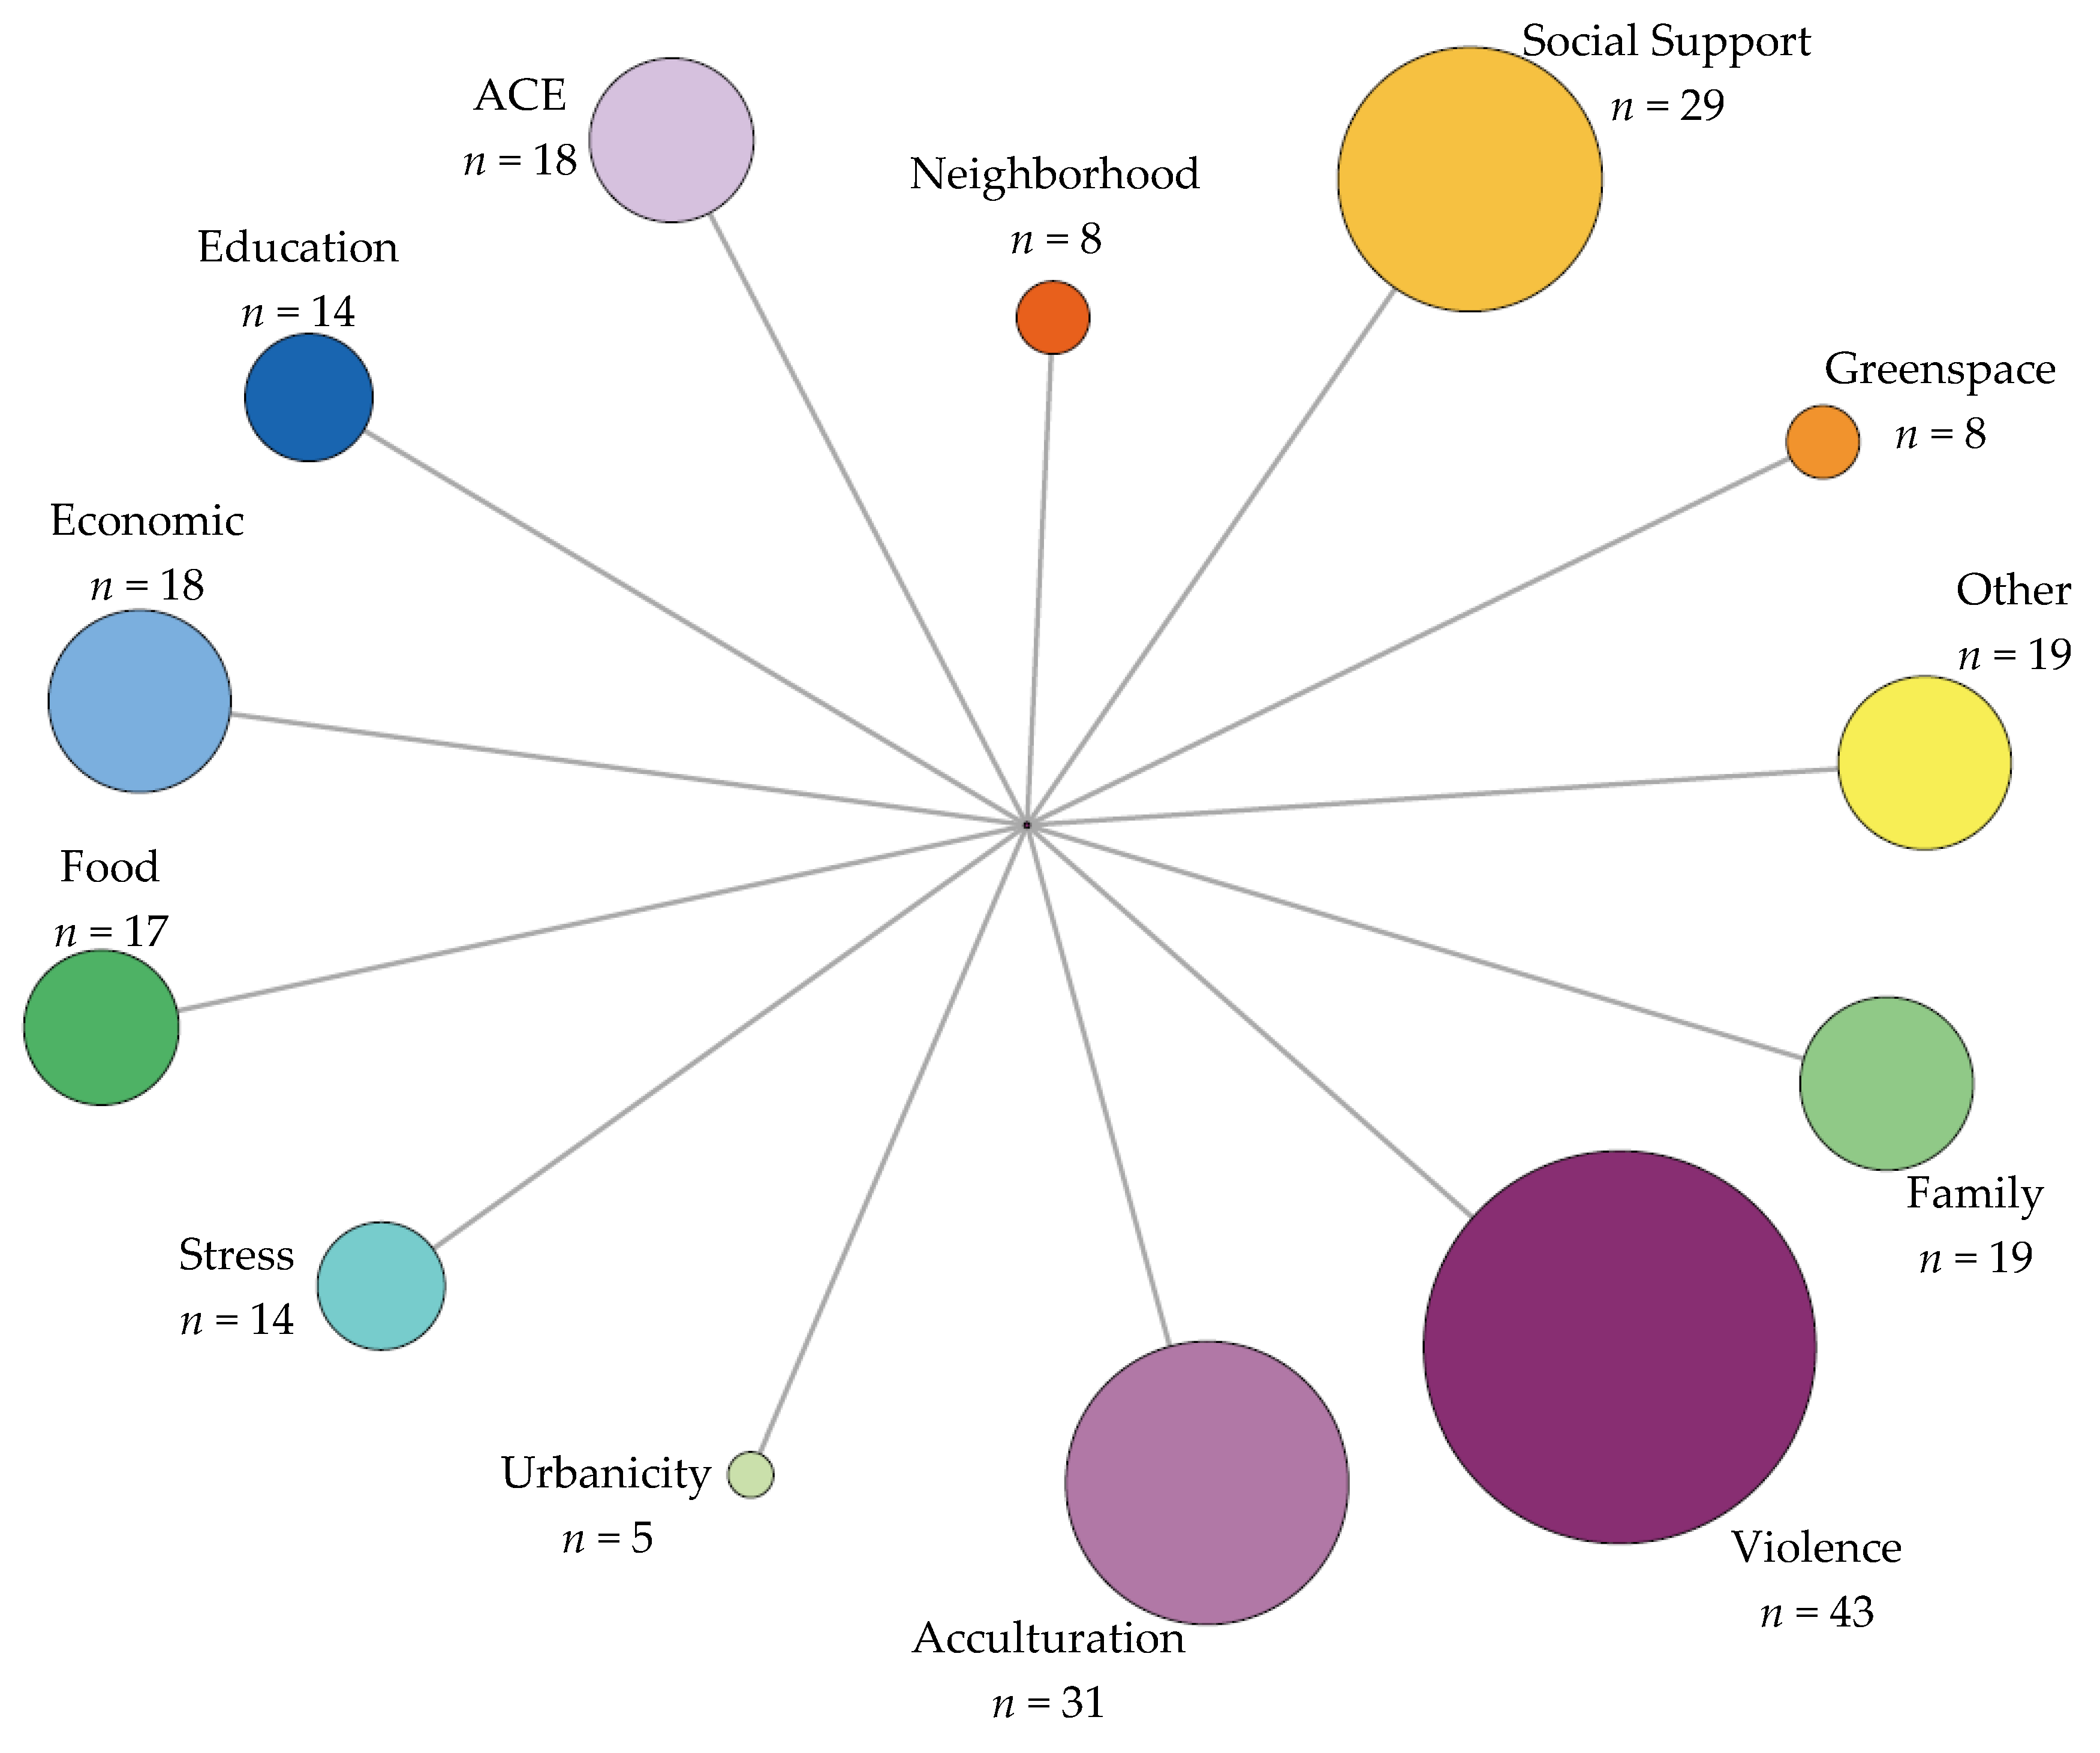
Non-chemical Stressors Frequently Examined in Pediatric Studies
Hibbert and Tulve. Int. J. Environ. Res. Public Health 2019, 16(22), 4417

Slide 14
Assessment of Allostatic Load
de la Rosa et al. Psychosomatic Medicine. 2023 Feb-Mar;85(2):108-117

Slide 15
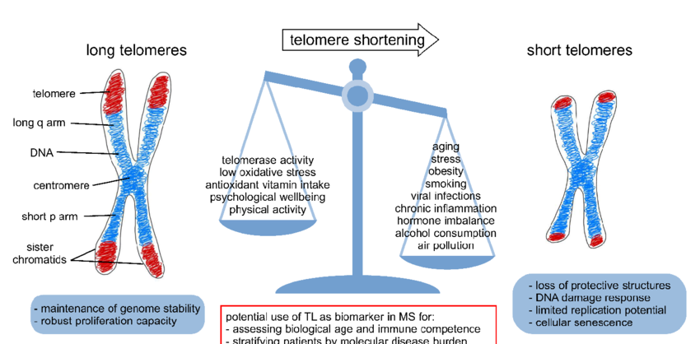
Chemical and Non-Chemical Exposures Have Been Associated with Telomere Length
Telomeres, DNA-protein structures capping chromosomes, shorten with each cell division and serve as a biomarker of aging.
Shorter telomere length has been associated with all-cause mortality and increased risk for age-related diseases such as cardiovascular disease
Shorter telomeres have been associated with both particulate matter exposure and adverse childhood experiences in children.
Image credit: Jan Bühring , et al. Aging and disease. 2021, 12(5): 1272-1286

Slide 16

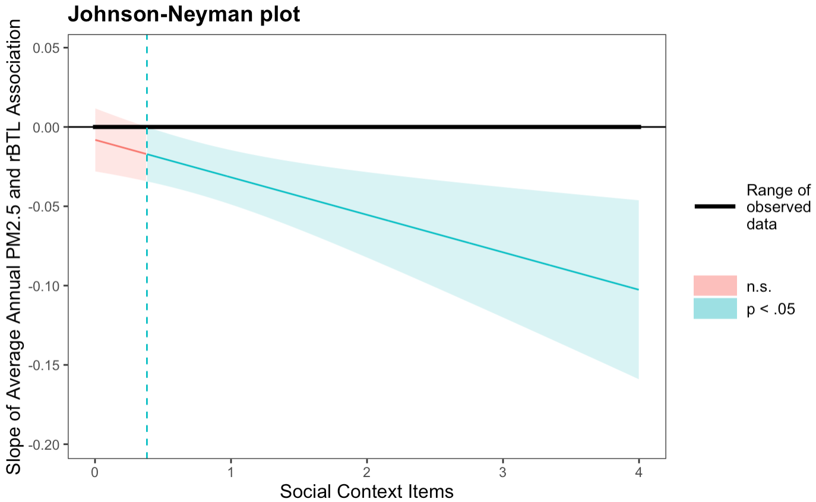

Social Context Domain Modified the Relationship Between PM_{2.5} and Shorter Telomere Length
A. Le
Social Context Domain
Neighborhood violence
Housing instability
Food Insecurity
Discrimination
de la Rosa R, Le A, et al. Psychosomatic Medicine 86(5):p 422-430, June 2024.

Slide 17
Future Directions: Using Exposomics to Assess Cumulative Risk
Smith MT, McHale CM, and de la Rosa R. (2019) Using Exposomics to Assess Cumulative Risks from Multiple Environmental Stressors.
M.T. Smith, R. de la Rosa, and S.I. Daniels, Environmental Molecular Mutagenesis, 2015; 56(9):715-23.

Slide 18



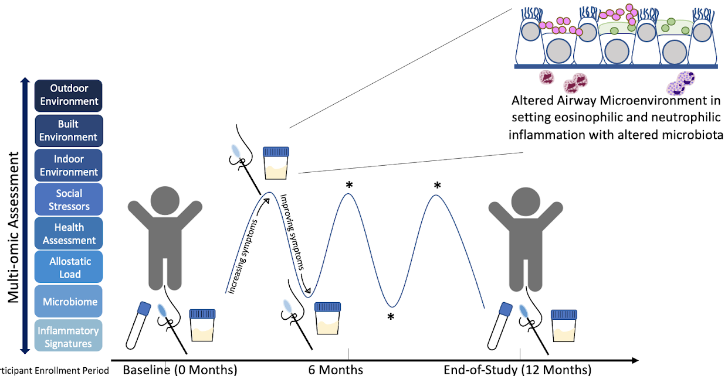
DSS: EXPAND-Asthma Cohort
U01HG013276 Funded by NHGRI and NIEHS
The Cohort:
Youth (8-16yrs) with (n=200)/without (n=100) asthma with/without high stress & pollution burden Recruited from Richmond, CA, a predominantly Latine community with high socio-environmental stressor burden
MPIs: S. Christenson and N. Thakur (UCSF)
Exposures
Chemical
PFAS (serum, Washington University St. Louis)
Urinary metals (University of Illinois Chicago)
Indoor and outdoor air pollution (PM_{2.5})
Psychosocial Stressors
Individual Level: Perceived Stress Scale, ACEs/PEARLS, Acculturation Scale, etc.
Neighborhood Level: CES4.0
Buffering Factors: Resilience (CYRM), Social Support, Neighborhood Health & Green Space
Omic and Clinical measures (Blood)
Genomics (WGS)
Transcriptomics (RNA-seq)
Epigenomics (ATAC-seq &WGBS)
Proteomics (mass-spectrometry and Olink)
Metabolomics
Clinical labs: Hba1c, lipid, liver function tests, CBC, IgE (Phadiatop)
Blood & Urine
Blood & Urine
https://www.mohdconsortium.org/home
Notes:
The Multi-Omics for Health and Disease Consortium

Slide 19
Questions?
Rosemarie de la Rosa
Email: rmd1025@berkeley.edu

