Slide 1
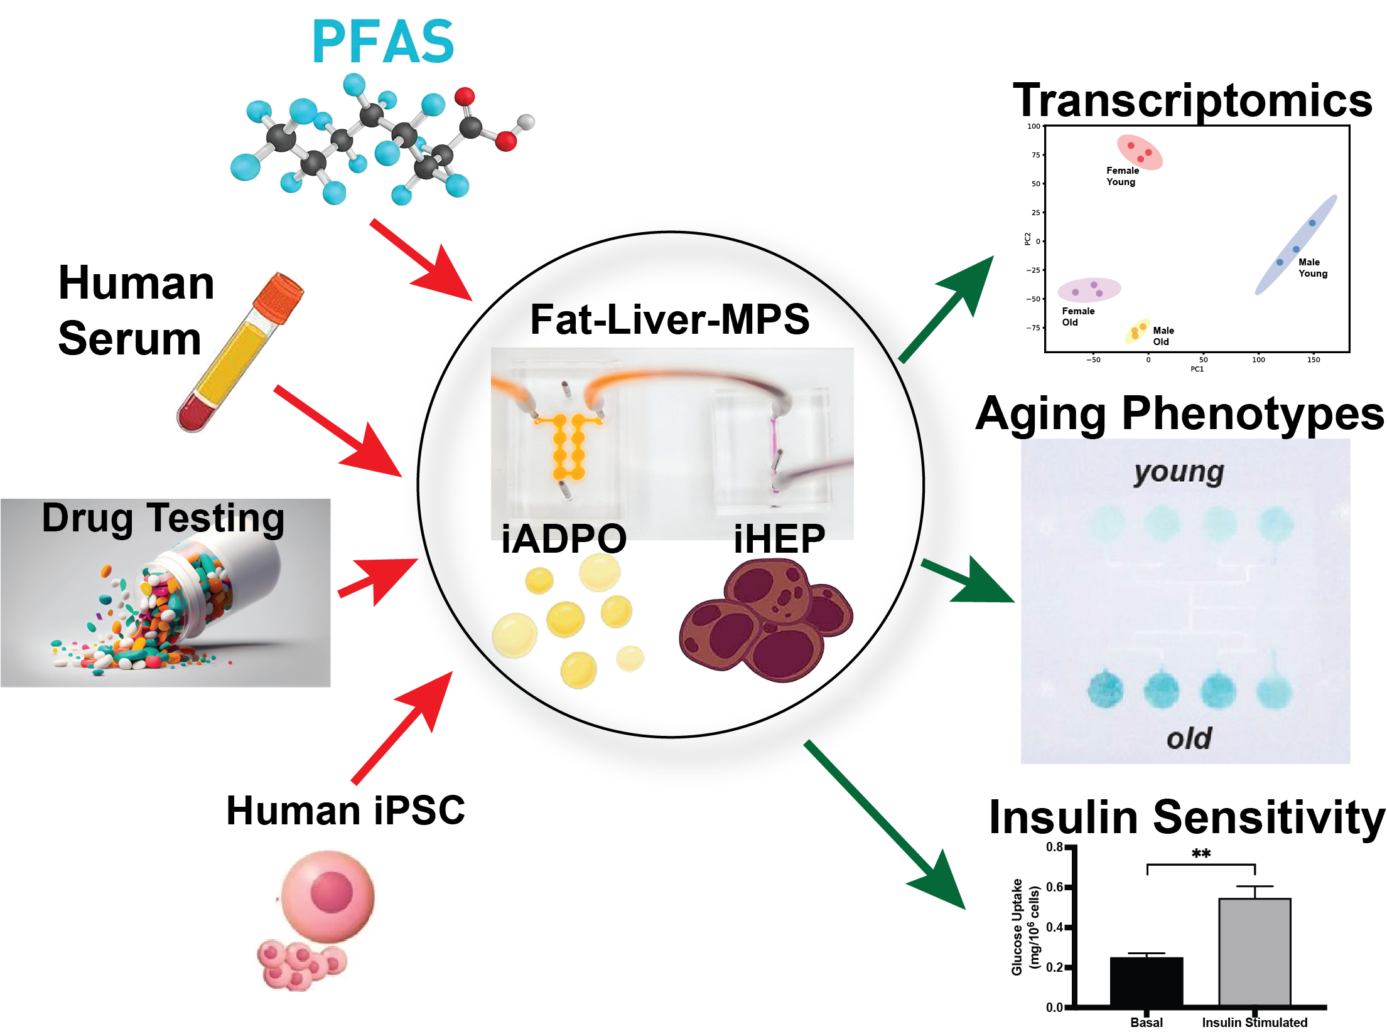
Functional Assessment of Endocrine Milieu using Organ-on-a-Chip Systems
PFAS COP Meeting
04/07/2025
Andreas Stahl
UC Berkeley

Slide 2
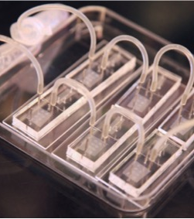
Multi-Tissue Systems to Interrogate Organ Cross-Talk in Aging
Why MPS and human iPSC?
MPS offer:
  Clearly defined engineered systems for key components of metabolic circuits
  Physiologically relevant tissue to media volumes
  Microcirculation mimicking in vivo transport
  Recapitulation of organ geometry & structure
  Multiorgan fluidic integration easily implemented
Human iPSC derived cell types offer:
  Relevance to human biology and diseases
  Reproducibility and full characterization
  Defined genotypes
  Creation of fully isogenic multi organ systems
  Reflect human diversity
  Editable genetic profiles
Notes:
Controlled but reductionist vs. biomimetic but high variability
Renewable well characterized cell source but potentially questionable cell maturity vs. Mature patient specific cells but with high batch to batch variability

Slide 3
Functional Readouts in the iADIPO-MPS
3D iAdipo-MPS
Lipid Droplet Size
Locularity
Glucose Uptake
Fatty Acid Uptake
Lipolysis
Qi, …, Stahl, Small, 2021
Qi, …, Stahl, Small, 2023
Qi, …, Stahl, Nature Communications, 2024
Notes:
Lin

Slide 4
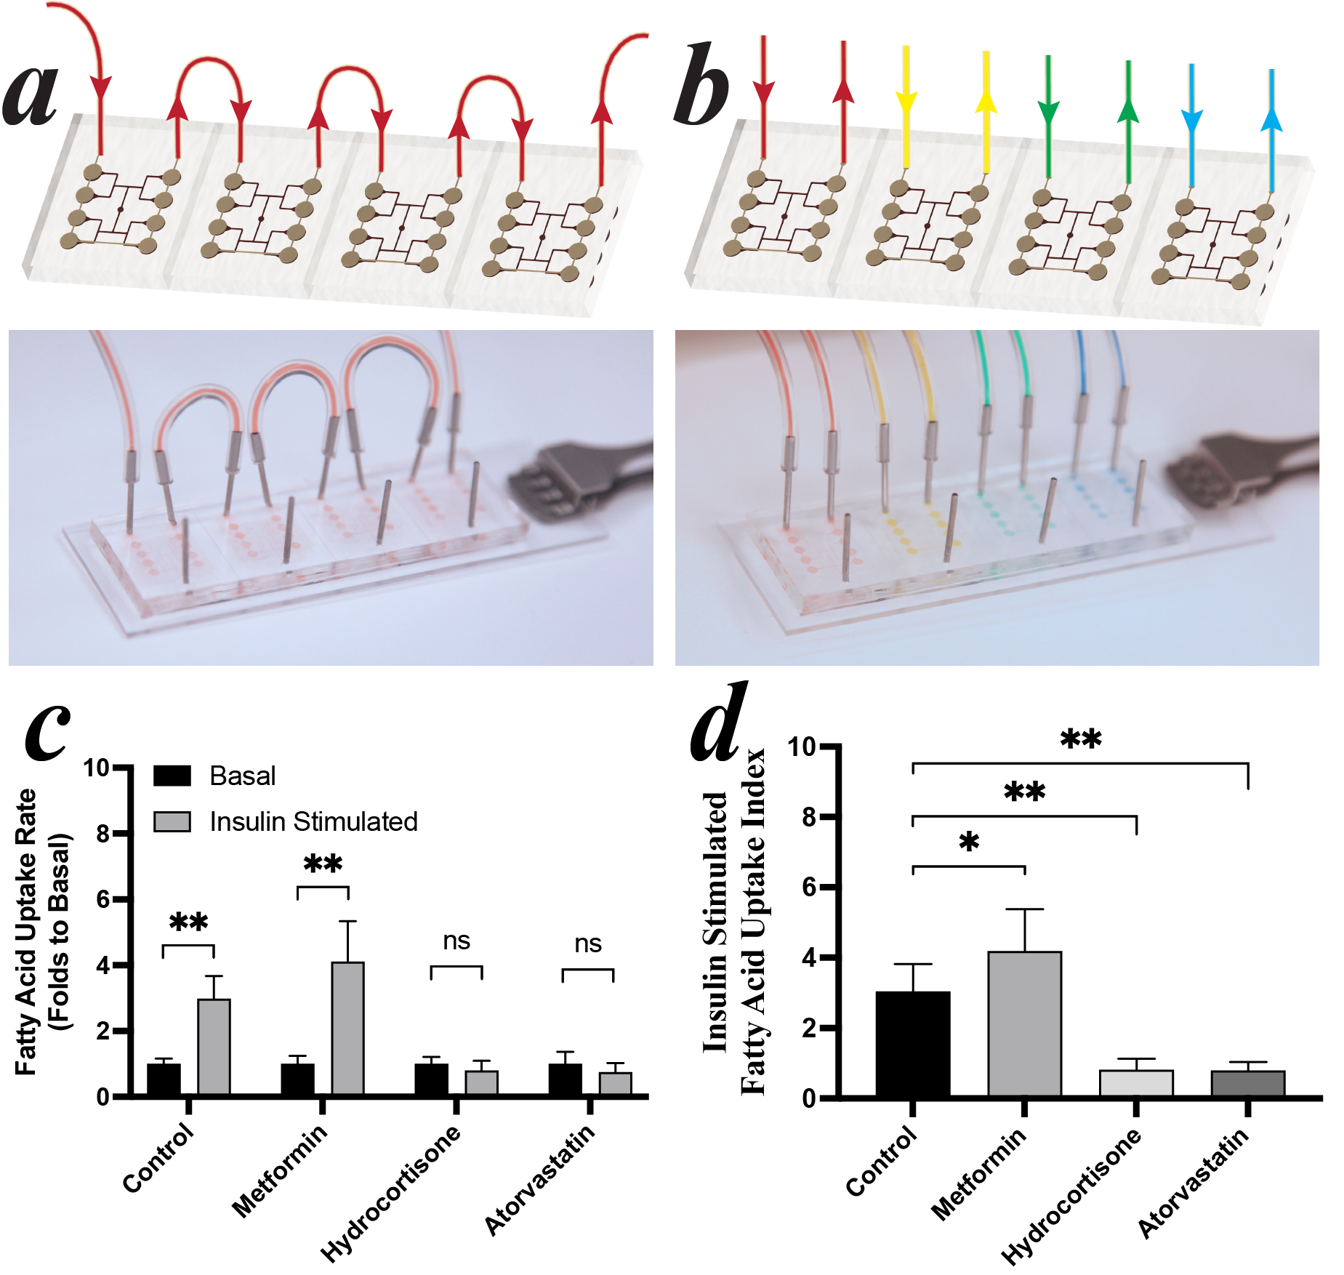
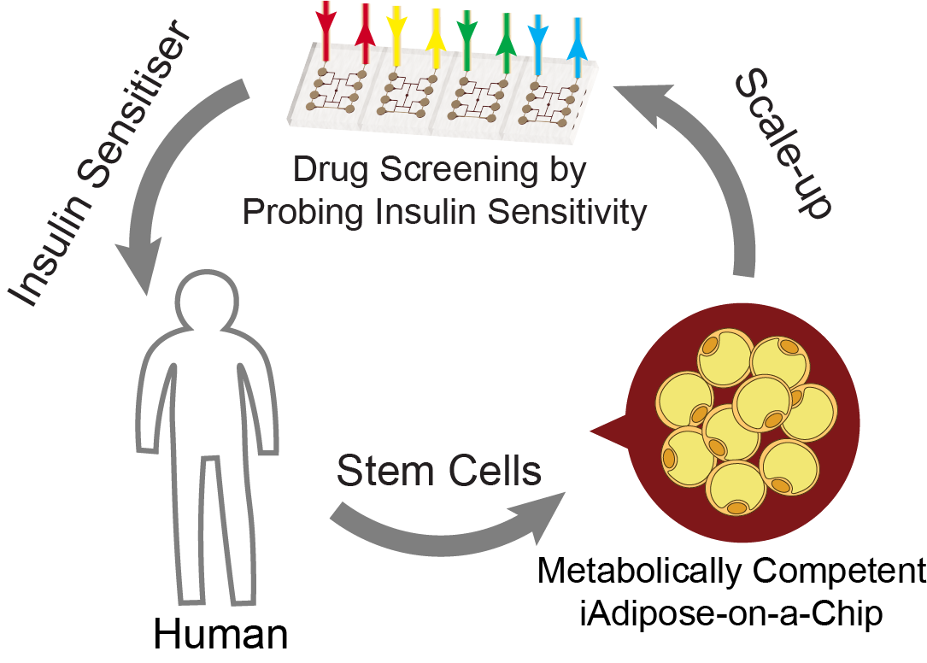
Functional Readouts in the iADIPO-MPS (#2)
Qi, …, Stahl, Small, 2021
Qi, …, Stahl, Small, 2023
Qi, …, Stahl, Nature Communications, 2024

Slide 5
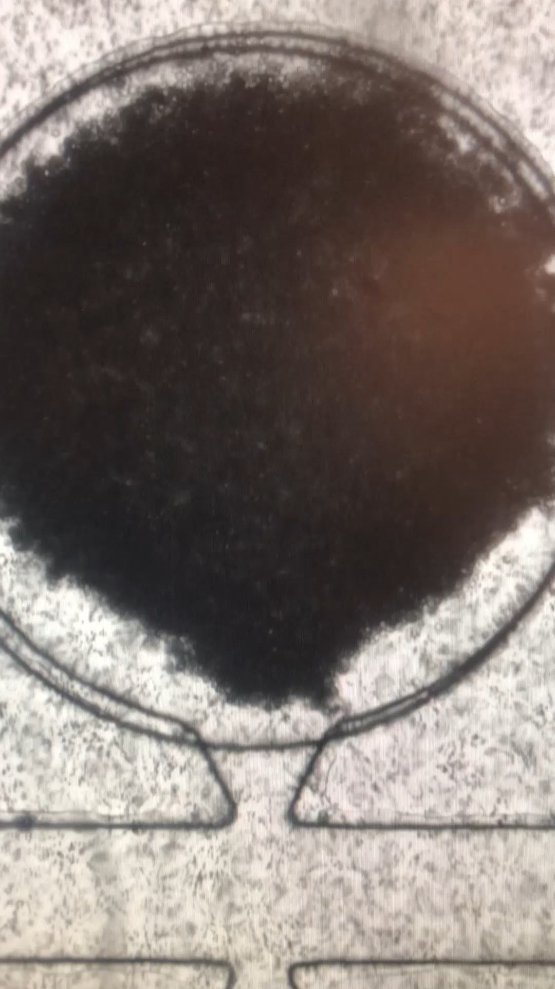
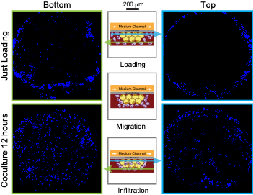
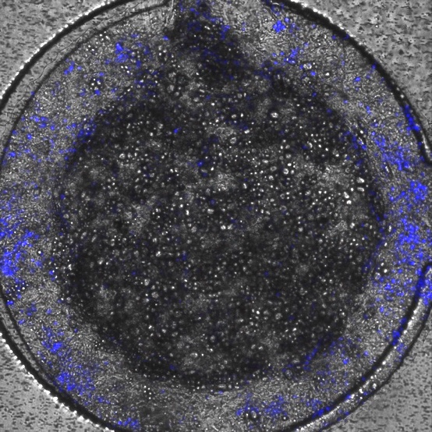
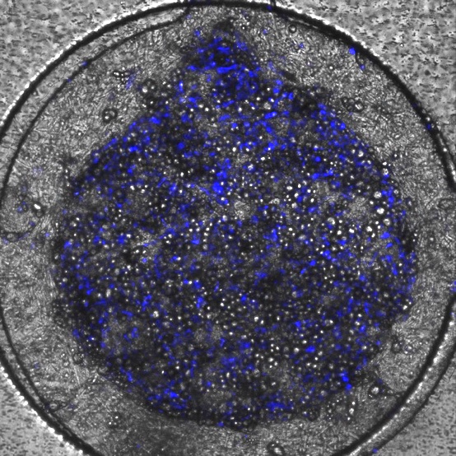
Functional Readouts in the iADIPO-MPS (3)
Loading Process
Macrophage Migration
Macrophage Infiltration
Just Loading
Mature A-MPS
Load M in A-MPS
Coculture 12 hours
M migrate, form CLSs, interact with A in MPS
Qi, …, Stahl, Small, 2021
Qi, …, Stahl, Small, 2023
Qi, …, Stahl, Nature Communications, 2024

Slide 6
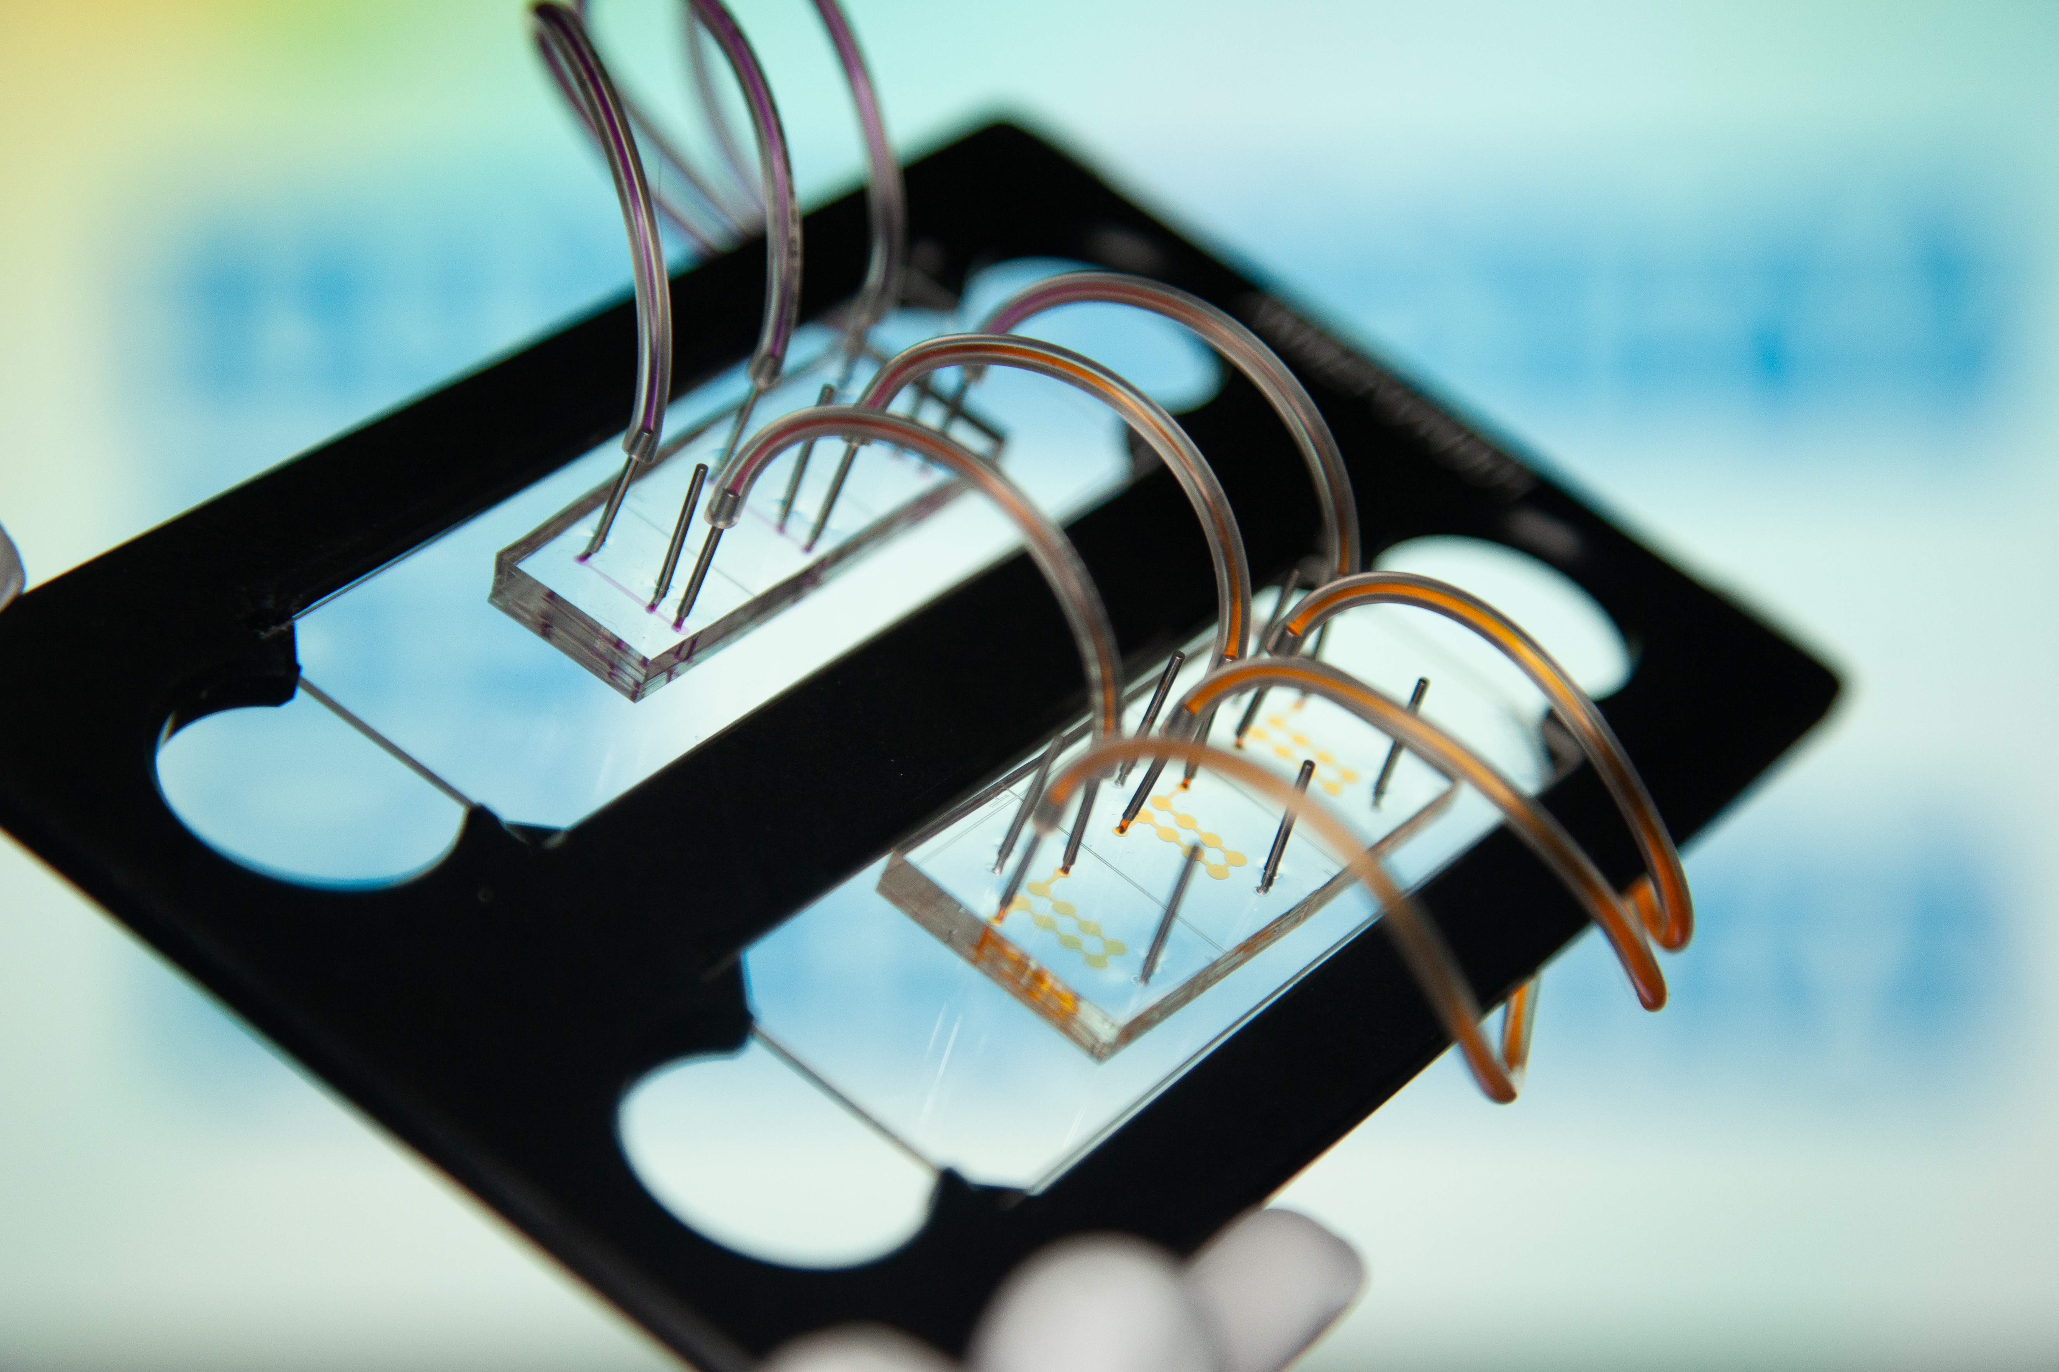
Integration of adipocytes with hepatocyte MPS
The iAH Chip
Qi, …, Stahl, Nature Communications, 2024

Slide 7
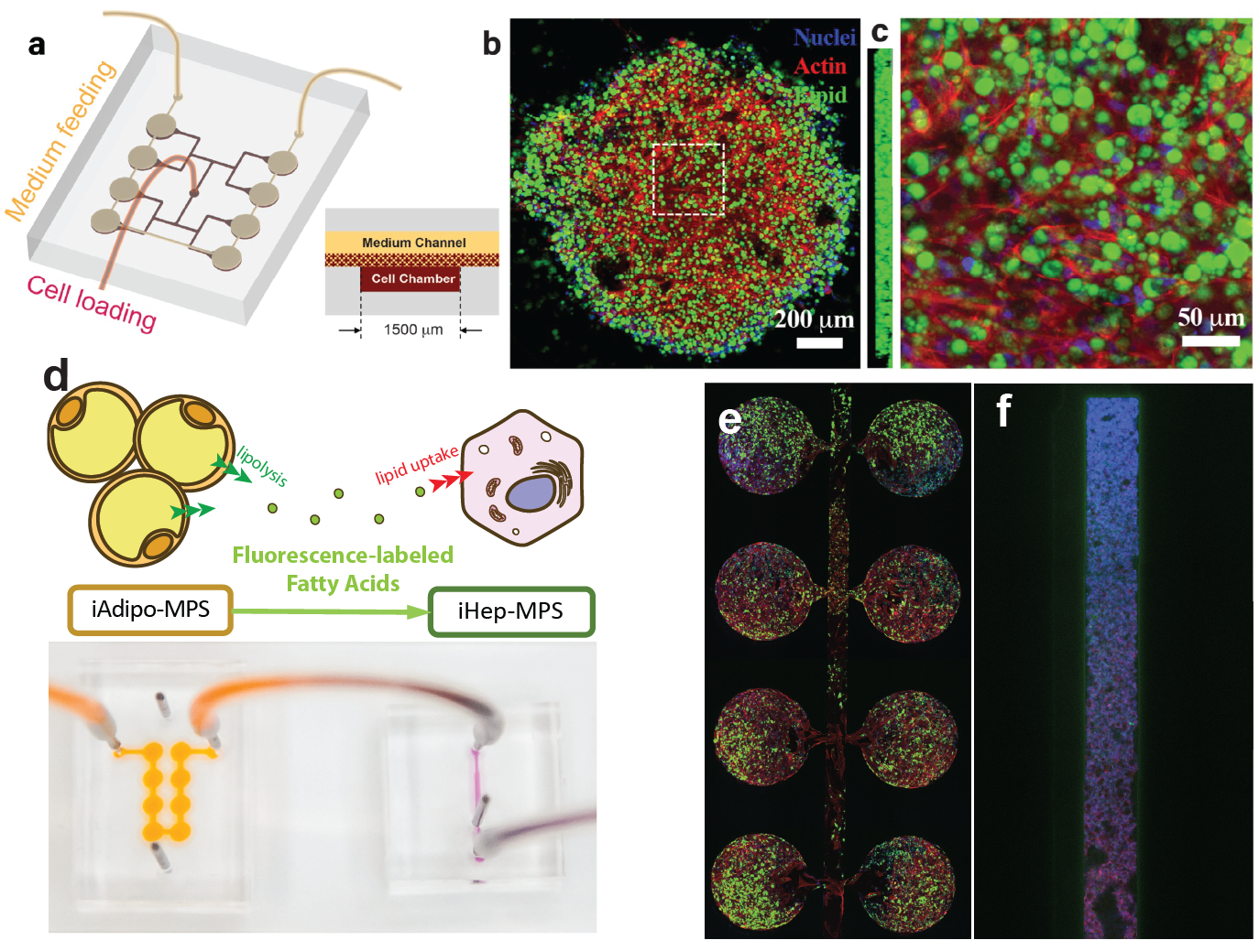
Integration of adipocytes with hepatocyte MPS (#2)
The iAH Chip
Qi, …, Stahl, Small, 2021
Qi, …, Stahl, Small, 2023
Qi, …, Stahl, Nature Communications, 2024

Slide 8
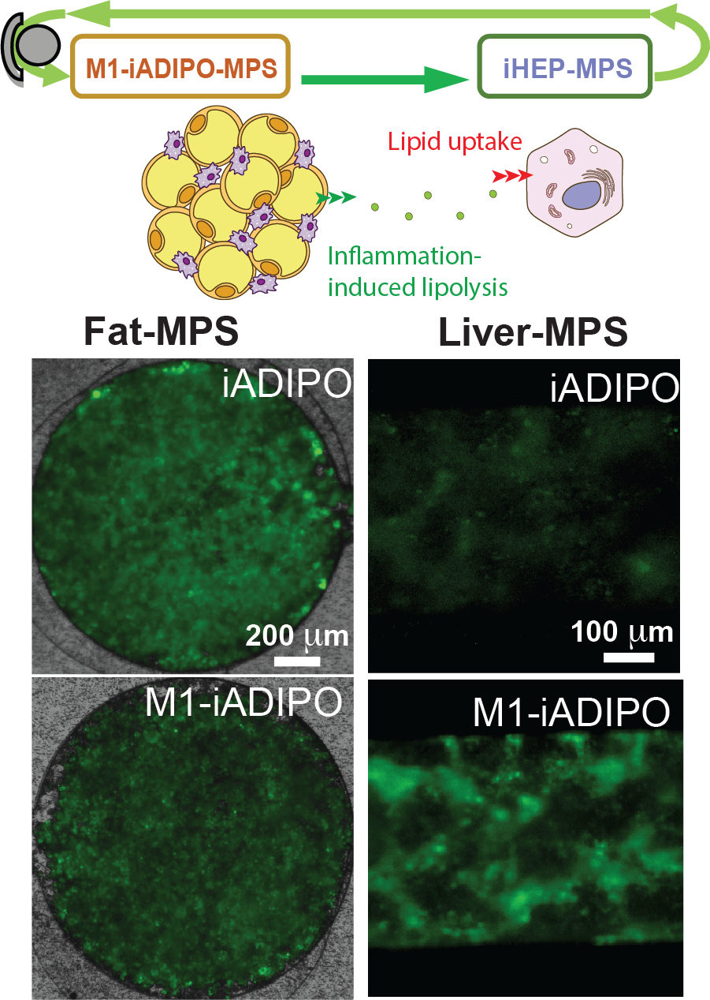
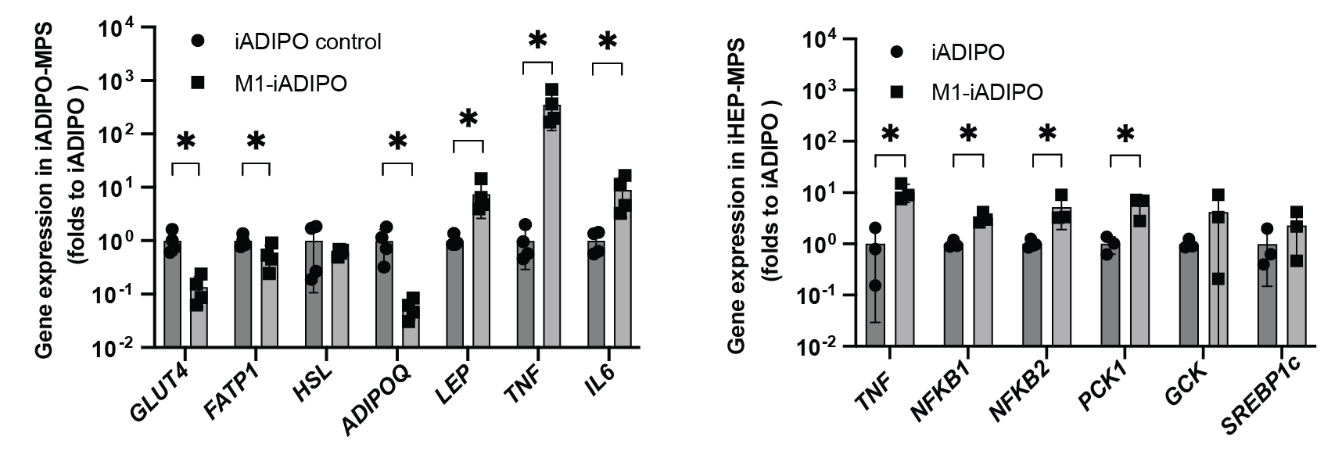
Functional Readouts in the iAH-MPS
Gene Expression
Qi, …, Stahl, Nature Communications, 2024;

Slide 9
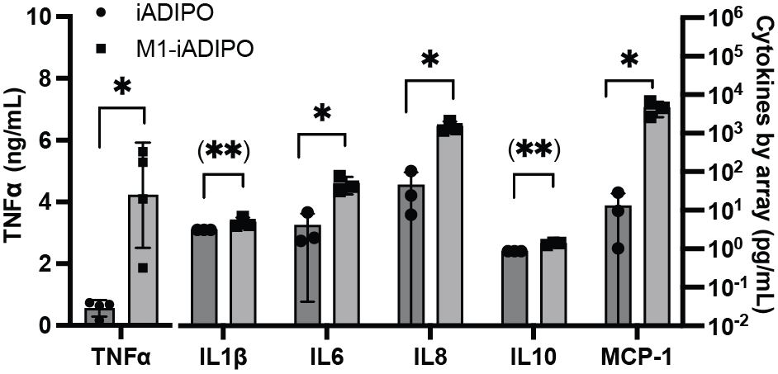
Functional Readouts in the iAH-MPS (#2)
Cytokine Levels
Qi, …, Stahl, Nature Communications, 2024;

Slide 10
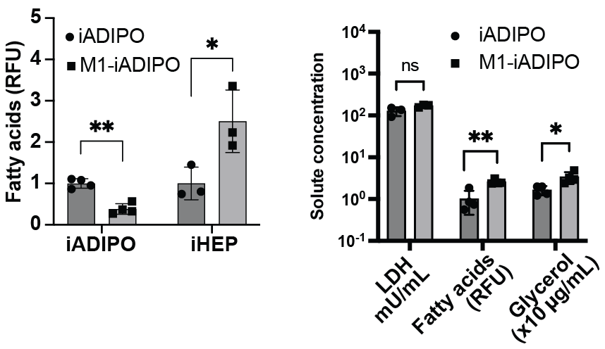
Functional Readouts in the iAH-MPS (#3)
Lipid Metabolism
Qi, …, Stahl, Nature Communications, 2024;

Slide 11
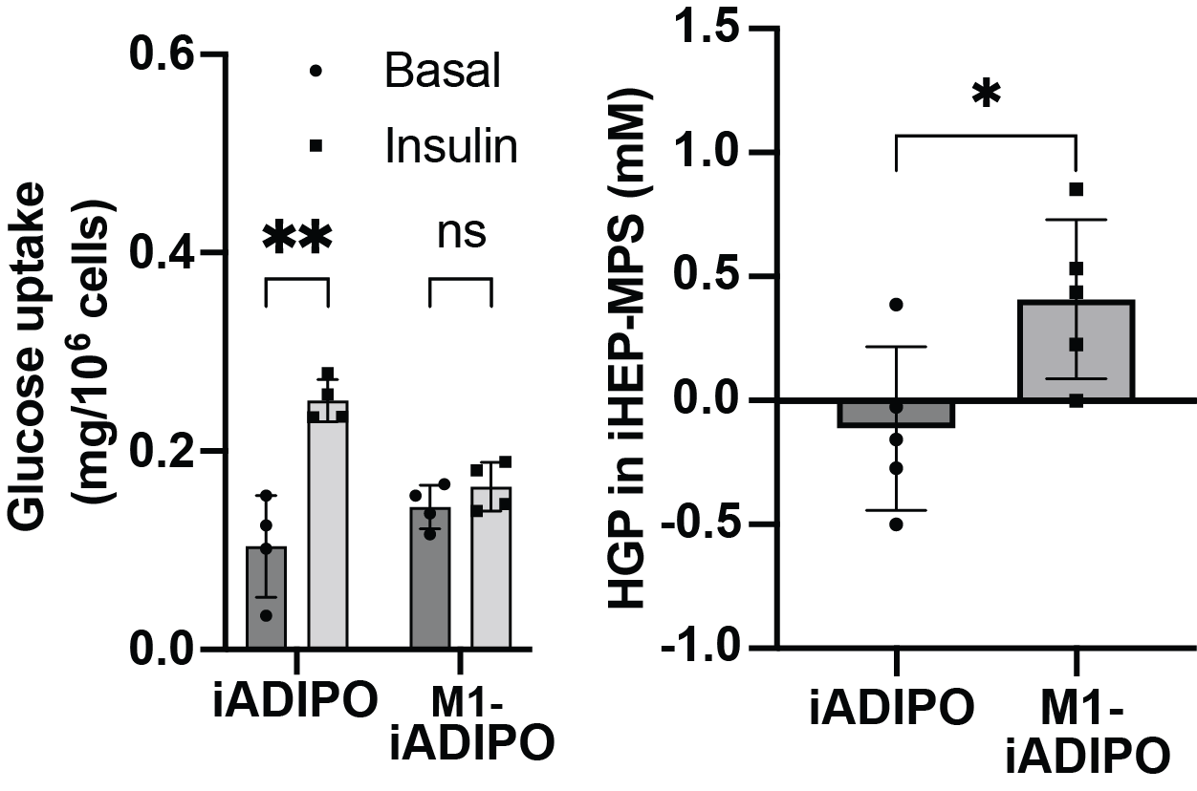
Functional Readouts in the iAH-MPS (#4)
Insulin Sensitivity
Qi, …, Stahl, Nature Communications, 2024;

Slide 12
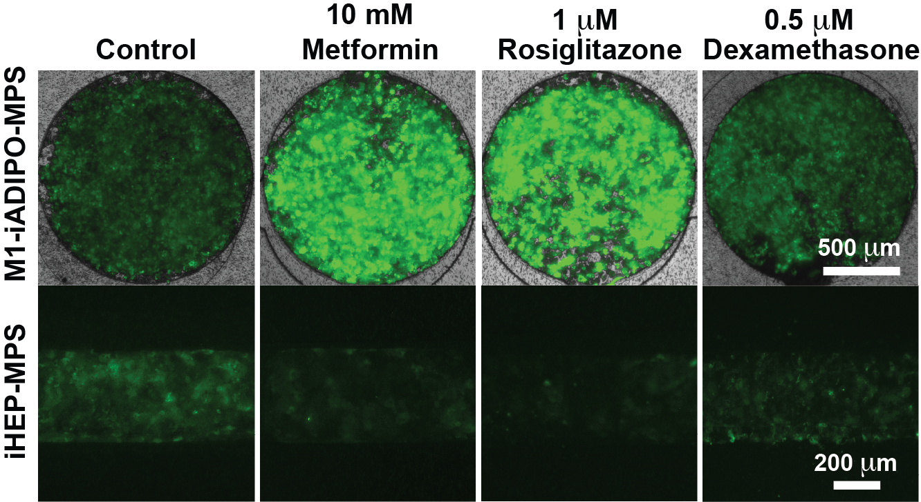
Functional Readouts in the iAH-MPS (#5)
Drug Testing
Qi, …, Stahl, Nature Communications, 2024;

Slide 13





Stahl lab:
Amanda Gunawan
Ching-Fang Chang
Diyala Shihadih
Garrett Dempsey
Irene Liparulo
Jessica Ortiz
Lin Qi
Pete Zushin
Yuchen He
Xue Wang
Collaborators:
Irina Conboy
Conboy Lab
R01CA221916, UH3 DK120004, R01DK118940, R01DK126830, T32 DK128783, Siebel Stem Cell Institute, CIRM Bridges Program

