Slide 1
Immunological effects of PFAS
PFAS Community of Practice:
Informing Policies to Protect Human Health and the Environment in California and EPA Region 9
Andres Cardenas, PhD
May 5, 2025

Slide 2
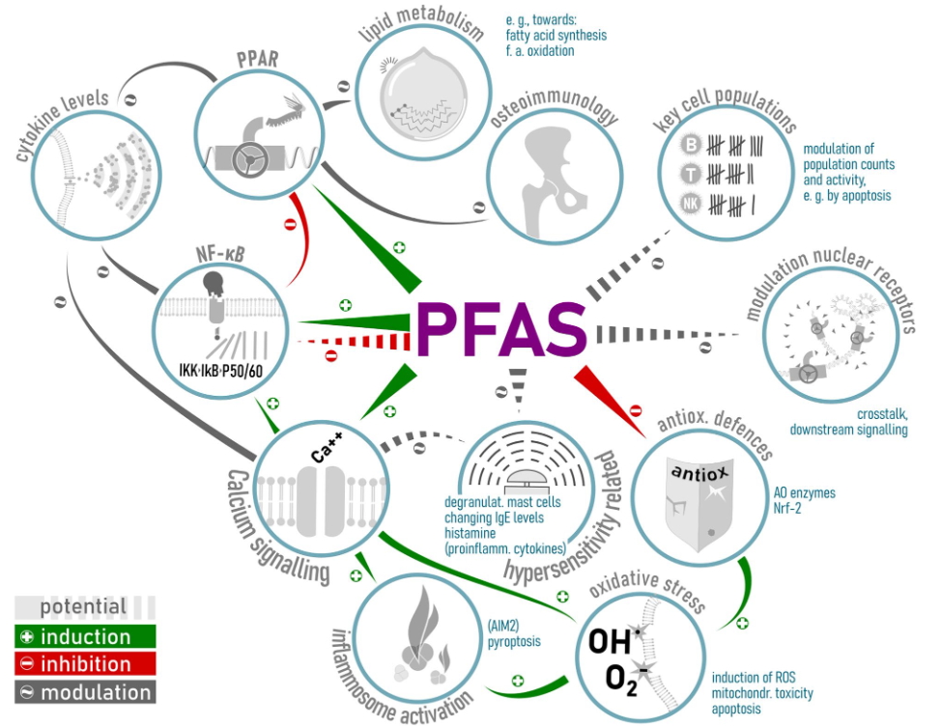
Proposed Mechanisms
Proposed mechanisms:
Induce inflammatory processes
Alter cytokine production
Interfere with processing & presentation of antigens
Modulate cell populations involved in antibody responses
Figure from Ehrlich V., et al. 2023 Enviro Health

Slide 3
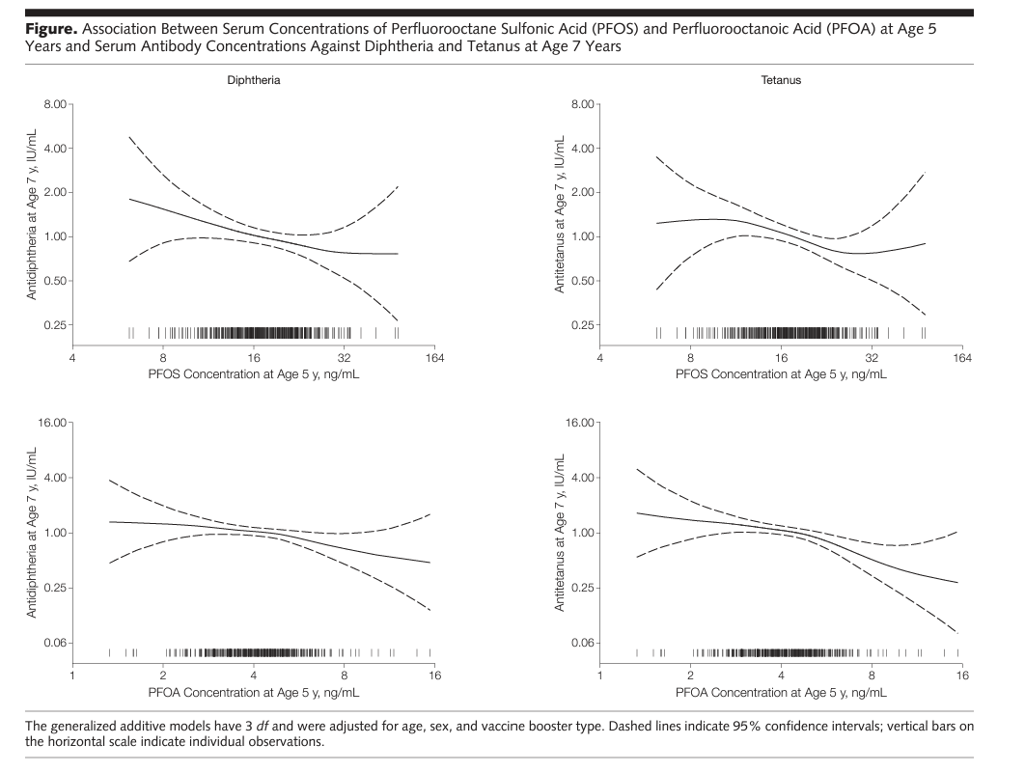
Early-life PFAS & Vaccine response
PFOS and PFOA and Associated ↓ Vaccine Response
Prenatal PFOS → 39% ↓ in diphtheria antibody
Age 5 PFOS/PFOA exposure → ↓ T/D
Age 5 exposures → Greater odds of falling
below clinically protected levels for T/D
Grandjean P, et al. JAMA 307.4 (2012): 391-397.

Slide 4
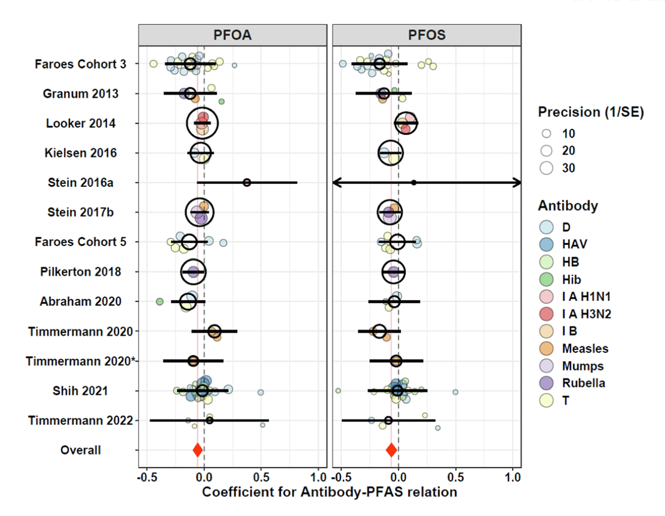
Vaccine response
Meta-analyses for multiple vaccines
14 studies, 13 unique
PFOA → 5% ↓ in antibody types
Diphtheria, Rubella, and Tetanus most supported
Only five PFAS evaluated
Crawford L, et al. Environment International 172 (2023): 107734.

Slide 5
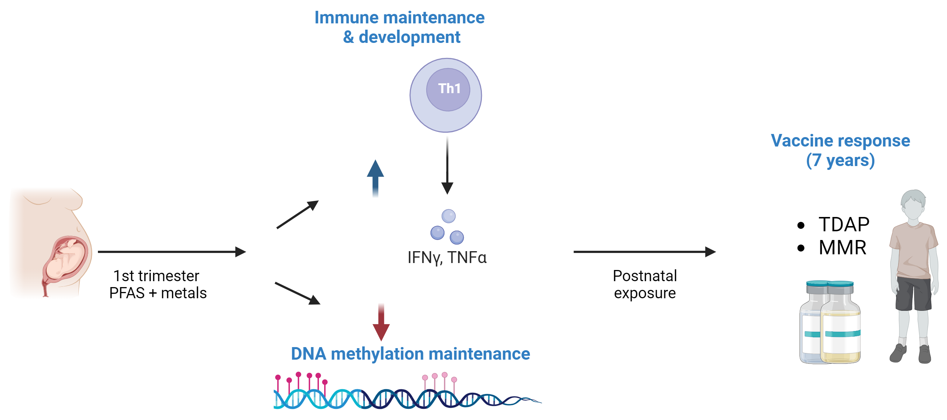
Project 2: UC Berkeley Superfund
Project under development

Slide 6
Prenatal PFAS & cord blood immune biomarkers
MeFOSSA associated with immune response biomarkers:
lymphocyte proliferation response after egg antigen stimulation
odds of having IFN-γ detected in response to dust mite antigen
lymphocyte proliferation after cockroach antigen stimulation (mixtures models)
Figure 1. BKMR estimates [95% credible intervals] for lymphocyte proliferation responses after stimulation with cockroach antigen (n=269), when PFAS at 75th vs. 25th percentile, under three scenarios (metals and PFAS set to 25th, vs. 50th, vs. 75th percentile).
Smith, Anna R., et al. Environmental research 259 (2024): 119555.
Notes:
Mixtures models included PFAS and nonessential and essential metals. Models adjusted for maternal age, pre-pregnancy body mass index, race and ethnicity, education, household income, smoking, parity, history of any eczema, asthma, or hay fever, and infant sex.

Slide 7
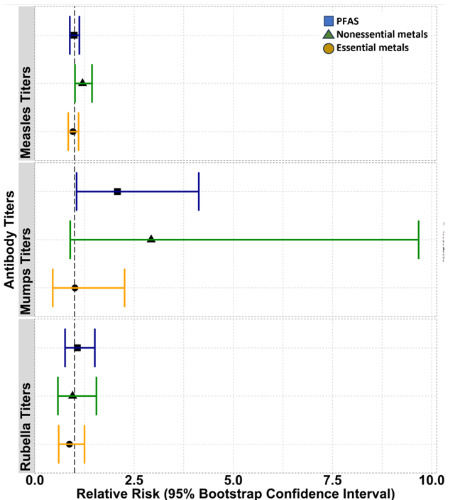
Prenatal PFAS & mid-childhood antibody titers
EtFOSSA & MeFOSSA associated with lower pertussis titers
MeFOSSA, PFNA, PFOA, & PFAS mixture associated with higher risk of having non-detectable or borderline mumps titers at age 7
Figure 2. Quantile g-computation adjusted relative risks per quartile increase in mixture (95% bootstrap CIs) for associations of PFAS mixture (PFOA, PFOS, EtFOSSA, PFHxS, MeFOSSA, PFNA) with non-detectable and borderline measles, mumps, rubella antibody titers, vs. detectable.
Under Review (2025)
Notes:
Adjusted for child sex at birth, age at blood draw, maternal age, race and ethnicity, body mass index, education, parity, smoking during pregnancy,

Slide 8
Discussion
Contact:
andresca@stanford.edu

